Slide 1
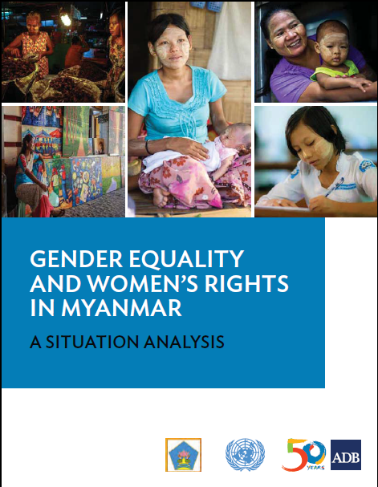
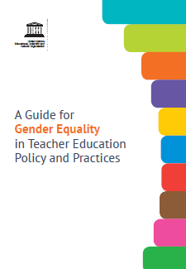
Equipping Youth for Employment (EYE) The Inclusion of Social Dimensions in the Curriculum
Yangon
December 2017
Yin Yin Aye
EYE- Curriculum Development & Social Impact Team

Slide 2
Introduction to Social Dimensions- Session Agenda
Background & Overview of EYE Project (5 min)
Social dimensions in curriculum development (5 min)
Why is understanding and incorporating social dimensions important in curriculum reform? (10~ 15 min)
Understanding and Limitations for incorporating Social Dimensions ? (10 min)
Discussion on group work/ findings (10~15 min)

Slide 3
Equipping Youth for Employment (EYE) — Overview
A 6 year, ADB funded project (2017-2022) providing support to MOE secondary education sector (SES) and technical and vocational education and training (TVET)
OUTPUT 1. Policy frameworks and capacities for cohesive, workforce- responsive SES and TVET enhanced
OUTPUT 2. New SES curriculum delivered and access expanded
OUTPUT 3. New TVET programs introduced and access expanded
EYE Activity Area 2A1:
Continued capacity building for SES curriculum development

Slide 4
Social Dimensions in Curriculum Development
What are Social Dimensions and why are they important?
Social Dimensions
Gender, ethnicity, race, religion, age, wealth, (dis)ability, vulnerability, and other social and society factors
Influence
Decision making, access to services, resources, opportunities, ability to engage in productive economic and social life and to cope with risks.

Slide 5
Social Dimensions in Curriculum Development
To succeed in equipping students with the knowledge and skills they need to succeed in the 21st century, the curriculum reform process will integrate awareness of social dimensions:
Changing political, economic and social conditions of the country;
The diversity of backgrounds, experiences, cultures and values of the many people of Myanmar;
Awareness and understanding of local, national, regional and international standards, practices and experiences on integrating social dimensions into curriculum development.

Slide 6
Why is understanding and incorporating social dimensions important in curriculum reform?
Why is gender an important issue in the development of curriculum?
Why is ethnicity and ethnic languages an important issue in the development of curriculum?
Why is disability an important issue in the development of curriculum?
Why is poverty an important issue in the development of curriculum?

Slide 7
Social Dimensions CDT Group Discussion Summary
Question: Why is gender an important issue in the development of curriculum?
CDT Response: All agree gender inequality exists and this may be due to cultural norms and traditions. In response, curriculum should be developed that is gender balanced and creates equal opportunity for all.

Slide 8
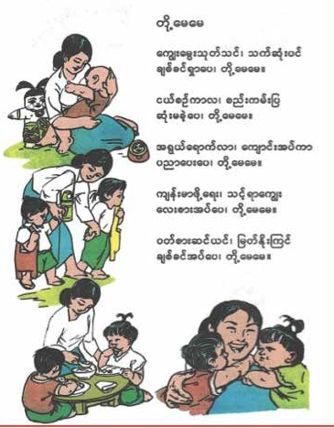
Roles in Society

Slide 9
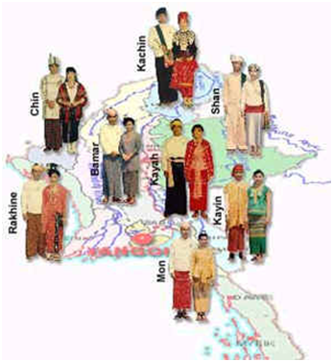
Social Dimensions CDT Group Discussion Summary
Question: Why is ethnicity and ethnic languages an important issue in the development of curriculum?
CDT Response: Complex issue that requires further discussion. Agreement that inclusive approach in education policy and curriculum reform on ethnic culture, language and diversity is important.

Slide 10
Social Dimensions CDT Group Discussion Summary
Question: Why is disability an important issue in the development of curriculum?
CDT Response: No child should be left out and the curriculum and pedagogy needs to be reformed to support sensitive and inclusive environment for every child, including children with disabilities.

Slide 11
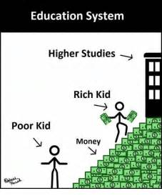
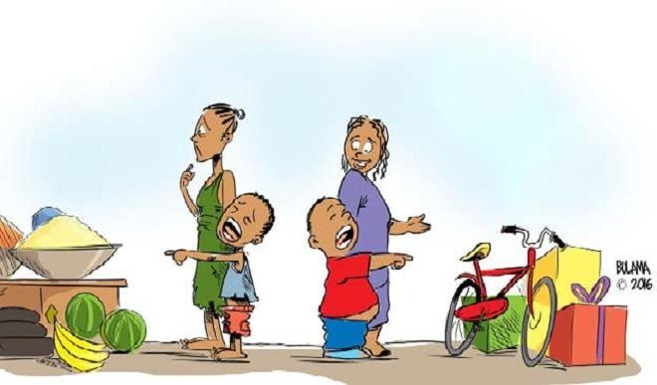
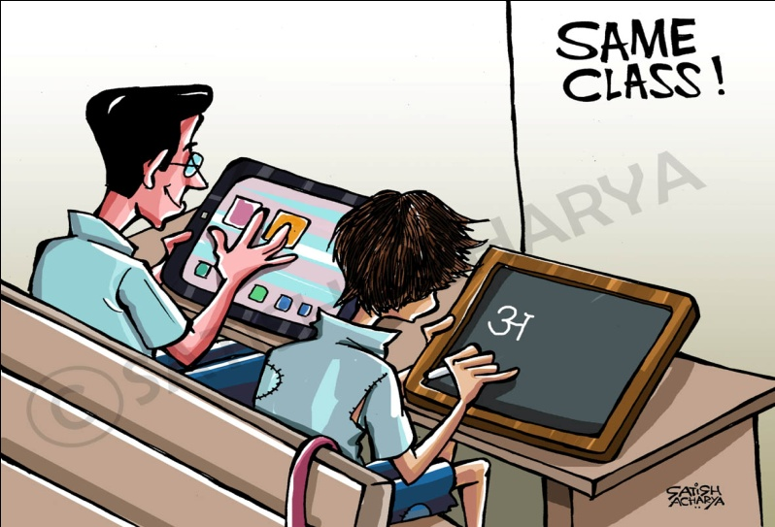
Social Dimensions CDT Group Discussion Summary
Question: Why is poverty an important
Issue in the development of curriculum?
CDT Response: Groups highlighted link between poverty, education and employment and the importance of both policy and implementation/operations. Some noted poverty is a barrier for SES and decent employment and that curriculum, classroom activities and pedagogy should be sensitive to all children regardless of income, family status or background.

Slide 12
Incorporating Social Dimensions & Limitations
Tool for Teacher Education
A tool to introduce the gender and other social dimensions to all aspects of teacher education and training, from policy & planning to curriculum development, pedagogy and instructional materials.
Transformation for Teacher Education
Gender mainstreaming and social dimensions requires a transformation in the culture of teacher education institutions, accountability, and teaching and learning processes.
Those links into national sector policies in many countries, however, still limitation due to several interconnected factors, transforming institutional cultures and practices remains a challenge.

Slide 13
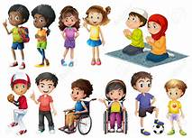
Institutional Culture & Environment
School environment can reinforce or lessen existing stereotypes and societal norms on gender and other social dimensions.
Notes:
Agenda (v)

Slide 14
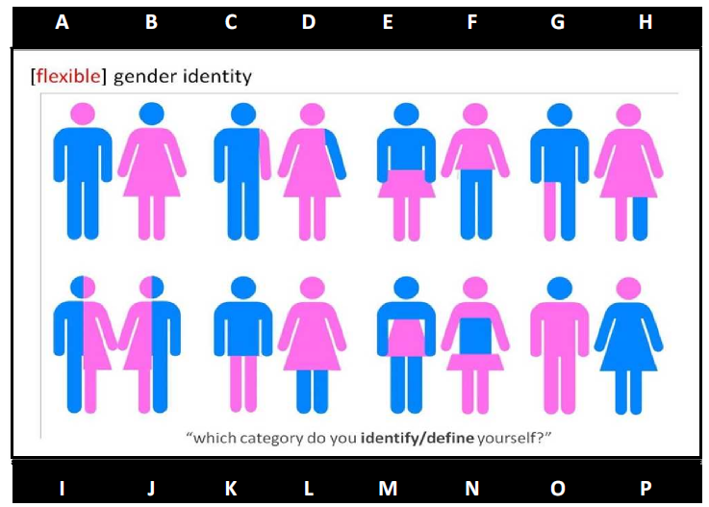
Introduction to Gender Dimensions (foundation for Institutional Culture & Environment)
Question: Is there a difference between gender and sex (male and female) and if so, what is the difference?

Slide 15
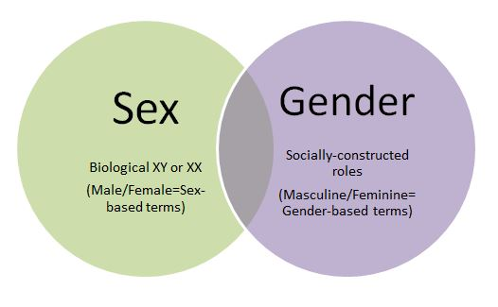
Extract - Social Dimensions in Curriculum Development – Session II Gender and sex? (foundation for Institutional Culture & Environment Contu.)
Sex refers to the biological and physiological characteristics that define men and women. Gender refers to the socially constructed roles, behaviors, activities, and attributes that a given society considers appropriate for men and women
Notes:
A Guide for Gender Equalityin Teacher Education Policy and Practices (UNESCO)

Slide 16
Discussion on group work/ findings

Slide 17
Reference, Publication & Useful websites
https://www.adb.org/publications
http://asiafoundation.org/publications/
http://www.themimu.info/sector/education
https://en.unesco.org/themes/116775/publications/all
http://www.un.org/womenwatch/daw/cedaw/reservations-country.htm

