Slide 1
SOCIAL STUDIES
LESSON PRESENTATION
By Hilda Tuimur , Nyaga E. Njiru and Janipher A.Ocholla

Slide 2
TOPIC
DEMOCRACY AND HUMAN RIGHTS
SUB TOPIC
MEANING OF DEMOCRACY.
CLASS: SIX.
UNIT: SIX.
October 2016.

Slide 3
EXISTING KNOWLEDGE OBJECTIVES
By the end of the lesson the learner should be able to:
1-Define the term democracy.
2- Mention three ways in which democracy is practiced at home.
3- Mention three ways in which democracy is practiced in the school setting.

Slide 4
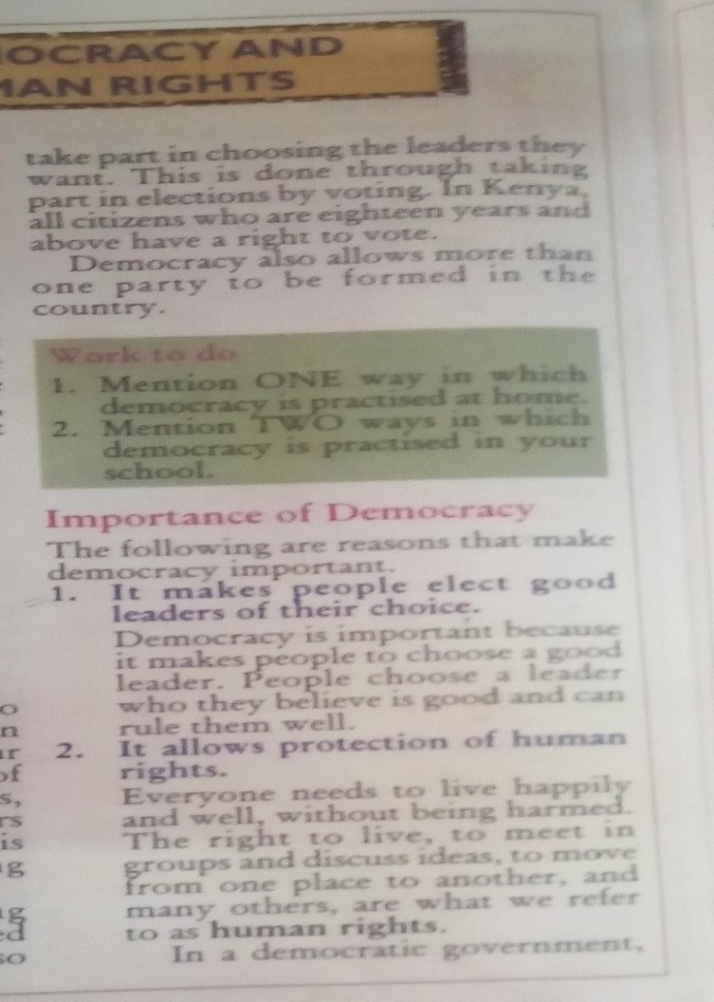
OUR LIVES TODAY BOOK 6 Pg.72

Slide 5
COMPETENCE OBJECTIVES
By the end of the lesson the learner should be able to:
1- use his/her knowledge of social events to demonstrate an understanding of how democracy is practiced at home.
2- use significant examples to describe some ways in which democracy has been practiced in the school setting over time.
3-Appreciate and apply democratic practices in their daily lives

Slide 6
References and Materials
Obiri,T (2010) Our lives today book 6 page 72
Obiri,T (2010) Our lives today Teachers Guide/manual . page 68
Obiri,T (2010) Social Studies Work Book 6
https://www.youtube.com/watch?v=u6jgWxkbR7A
https://www.youtube.com/watch?v=RhUx1pArrO4
The school and its environment.
The constitution of Kenya 2010 article 10 and chapter 6
Picture cutouts on democratic practices.

Slide 7
RATIONALE
The central purpose of social studies education is the development of citizenship. In social studies education four elements are essential. The first element is knowledge. Social studies must draw heavily upon the other social sciences, including history, and from related fields such as law, psychology, the humanities, journalism, and the arts. Knowledge must be balanced between understandings needed in young people's own immediate social worlds and society at large, The second element is values. This is by Identifying their own values and recognizing the values of others. The third element is skills in acquiring information and thinking about social affairs. Young people need skills to make their knowledge and values active and help them in the lifelong learning. The fourth element is social participation. pupils live as part of social groups, which they influence and are influenced by. Without these competences, social studies education becomes passive and worthless in their daily life.

Slide 8
LEARNING AND TEACHIG EXPERIENCES
The students will watch a video clip and derive the underlying message based on the competence objectives.
A discussion will be held to further apply their knowledge on social happenings to develop new knowledge in a school setup.
A plenary session will be held for presentations
The content will be harmonized using the teachers checklist.

Slide 9
TEACHING AND LEARNING ACTIVITIES
STEP/TIME | TEACHERS ACTIVITY | LEARNERS ACTIVITY
1.INTRODUCTION 5.Mins. | -Watch a video clip on the meaning of democracy and its origin. https://www.youtube.com/watch?v=u6jgWxkbR7A | -Watch listen and answer questions from the video clip.
2 LESSON DEVELOPMENT 25. mins. | -Display and discuss pictures on democratic practices at home. -Group the learners to watch a video clip on democratic schools education. https://www.youtube.com/watch?v=RhUx1pArrO4 -Give an activity to discuss how democracy is practiced and applied at school. -organize learners for presentation of their deliberation. -Note and address emerging issues. | -Observe the pictures and contribute in the discussion. -form discussion groups and watch the video clip. -Participate in the group discussion. -Group leaders present their findings. -Record emerging issues.
3.CONCLUSION 5.mins. | Highlight and consolidate the pupils work. -Give a take away assignment | -Take notes on the points raised.

Slide 10
KEY COMPETENCIES
Communication as they discuss with peers.
Creativity in trying to interpret the video clips and raise own points.
Problem solving in that they will have an activity based on the school experiences.
They will also learn how to respect other students opinion as they discuss and agree on what to present.

Slide 11
FURTHER APPLICATION
If the four elements translate into actual learning opportunities then the students are able to not only internalize the content but also put it in practice and therefore educating them in a holistic manner which produces a constructive citizenry .

Slide 12
FEEDBACK
SELF EVALUATION.

