Slide 1
UNESCO-IBE Training on competence based curriculum Science/Applied Science group work July, 2016
KENYA INSTITUTE OF CURRICULUM DEVELOPMENT

Slide 2
Topic: Weather
Objective: by the end of the topic, the learner should be able to:
Identify different weather instruments
State the use of different instruments
Construct and use different weather instruments

Slide 3
Competence
Task: Converting to competence
Selected objective (c)
Process:
The objective broken into two to isolate the skills to read:
Construct different weather instruments useable in the learner’s environment
Use different weather instruments to measure prevailing weather conditions

Slide 4
Learner’s background
Target learner
Class 5 science learners
Learner’s context
Learner’s natural school environment

Slide 5
Teaching and Learning methods
Class project activity
Group project activity
Individual project activity
Class practical
ICT reference
The method to be selected based on the instrument/content to be studied.
Example:
Constructing a rain gauge

Slide 6
Learning materials
Used clear water bottles
Measuring jar
Funnel
Ruler
Pieces of wood or wooden stands
Paper strip or a strip of sticker
Glue
Pencil

Slide 7
Assessment methods
Assessment portfolio with:
Graded progress record on the project
Graded project output
Graded presentations
Graded observation of the learners ability to use the constructed instruments.

Slide 8
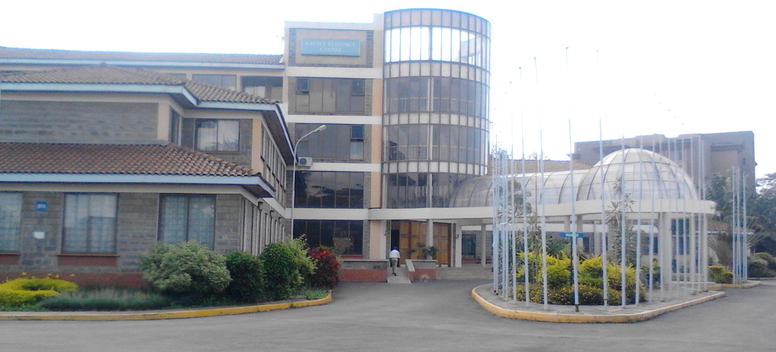
Rationale/justification
To combine knowledge of specific weather instruments to its innovative construction and usage.

