Slide 1
KICD – UNESCO – IBE Curriculum Workshop for Textbook Publishers 5-7 October 2016 Day 1 AM
Thomas Cobb Faculty of Education, Université du Québec à Montréal Lili Ji
International Bureau of Education
GENEVA

Slide 2
FOLLOW ON MOBILE OR REVIEW THIS PPT AT http://lextutor.ca/kenya2/day_3.1.pptx

Slide 3
Slightly revised agenda
Day 1 What is a competency approach?
Why does Kenya need it?
Day 2
What does it mean for textbook publishers?

Slide 4
Workload Division
Tom presents about 50% of the time
Participants are active the other 50%
Discussing with each other
Individual, pair, group
Reporting on discussions
Presenting
Inclusing final presentation with powerpoint

Slide 5
9h30-10h30 Backgrounder
Challenge for Africa of 2000’s (EFA, Millenium Goals, etc.)
ACCESS TO PRIMARY
Challenge for Africa of 2010’s
EXTENSION TO SECONDARY
INCREASE IN QUALITY
Kenya: “The process for curriculum reform in Kenya has been initiated and draft tools for needs assessment finalized.”
The theme of this reform is a “competence” approach to school learning

Slide 6
Backgrounder 2
There is a need now to bring teacher trainers and teachers on board for this reform through a discussion of :
what the reform means,
what it will cost them,
why they should invest in it, and
how it will affect them and their existing practices.

Slide 7
Backgrounder 3
First What we are not here to do:
We cannot provide a tried-and-true, established ‘method’ for how to put in place a successful CBE approach
“A Competence approach” is more an ideal than a reality at present, even in Europe / North America
Different CBE reform zones emphasize different things:
IN USA it is mainly about individual pace of learning and “mastery” types of assessment
In Canada it is mainly about the need to fully contextualize learning through “situation banks”
So, we feel that:
Kenya will largely find its own version of a competence reform, and
Anything we say should be taken as information and ideas rather than “a method” to be applied

Slide 8
Backgrounder 4
Second the type of information we do not propose to share with you: Multiple boxes and arrows
As typifies many or most “competency training” workshops …
Except where their meaning is fully explainable in the present setting and timeframe

Slide 10
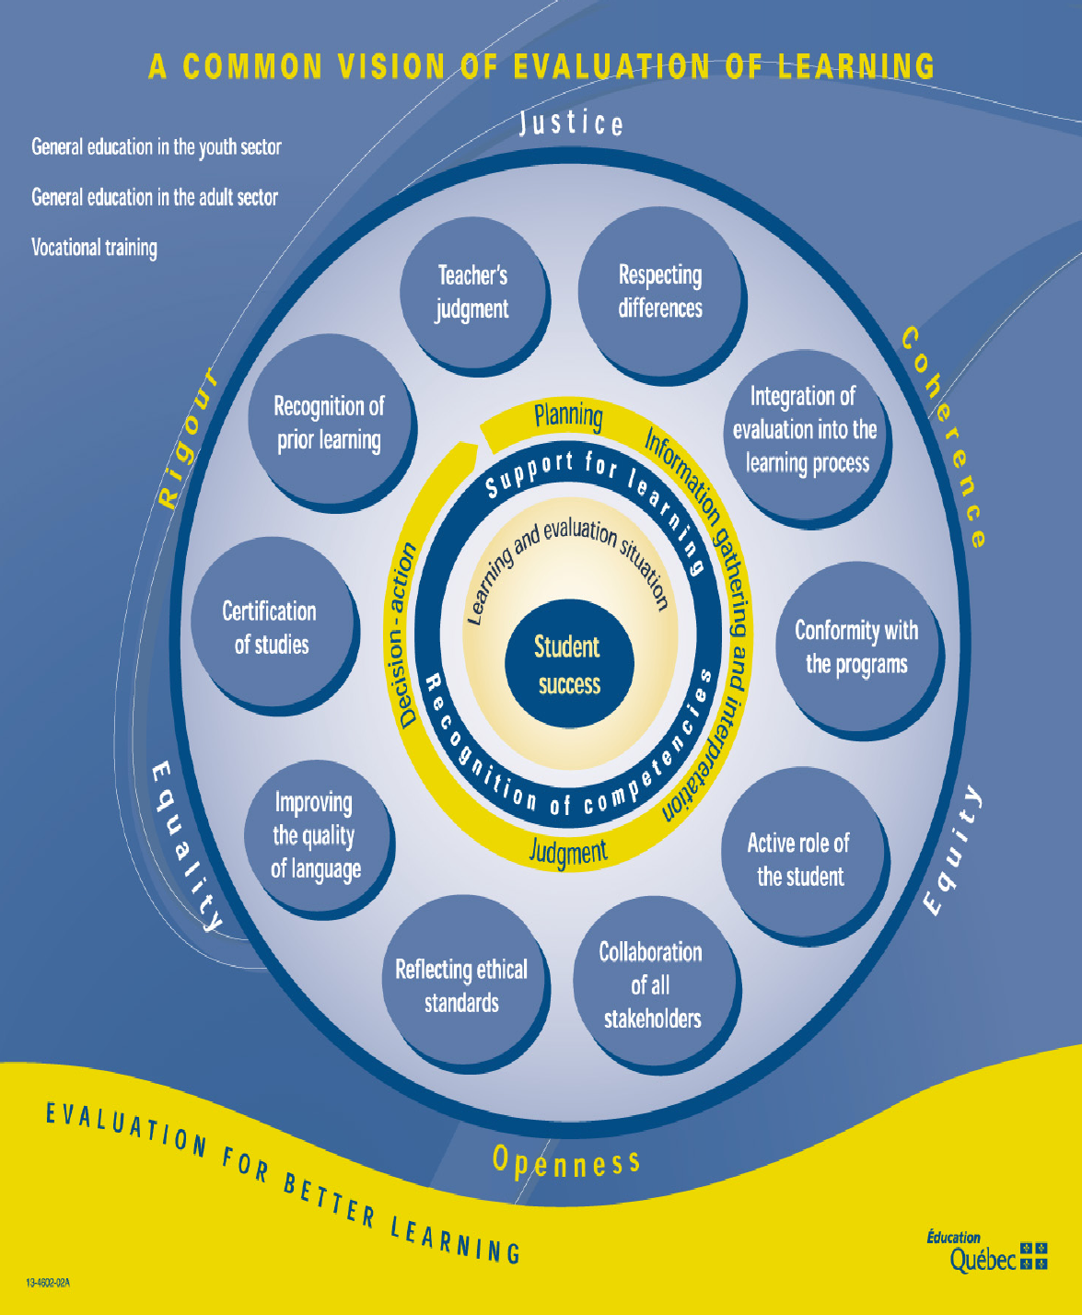

Slide 11
Which is not to say we do not find curriculum reform to be multi-faceted and complex !
This type of diagram hints at some of the number of elements and the complexity of their interactions
But at this stage we will adopt a more piecemeal approach
Look a the pieces individually, maybe fit them into some sort of ‘big picture’ later

Slide 12
Backgrounder 4
Key concepts :
A competence approach (CBE) vs. a knowledge approach;
Assessment of competence;
How CA functions in different regions, at different age levels, and in different domains;
Teaching methods & materials that are compatible with CBE;
the link between CBE & Constructivist learning theory;
the special roles in CBE for ~
problem solving
information technology

Slide 13
Objectives
Participants will leave the workshop able or better able to perform the following competencies:
Think clearly and usefully about educational goals and problems within their environments in a common competence framework
Develop concrete learning, teaching, and testing materials within a competence framework

Slide 14
Participants
Participants will include textbook publishers in several content domains
Upon whom the success of this whole reform to some extent depends
Teachers teach what is in the textbook not what is in the syllabus

Slide 15
Participant Groupings
We will ask you to participate in the following roles:
Individuals,
pairs,
double pairs, etc.
domain groups
(6 or 8, ideally, depending on numbers)
Note: variety of groupings are key to the competence concept – as we see later

Slide 16
Presentation
What is a competence approach?
Why do we need it?
Who benefits? Competence Approach as opposed to…?

Slide 17
From the KICD website glossary
Competence
“Within the European Union area a competence is defined as a combination of knowledge, skills and attitudes appropriate to the context. Competence indicates the ability to apply learning outcomes adequately in a defined context (education, work, personal or professional development). Competence is not limited to cognitive elements (involving the use of theory, concepts or tacit knowledge); it also encompasses functional aspects (involving technical skills) as well as interpersonal attributes (e.g. social or organizational skills) and ethical values.”
“Competences can be domain-specific … or general/transversal [cross-curricular] because they have relevance to all domains/subjects.”

Slide 18
From the KICD website glossary
Competence
“Within the European Union area a competence is defined as a combination of knowledge, skills and attitudes appropriate to the context.
Competence indicates the ability to apply learning outcomes adequately in a defined context (education, work, personal or professional development).
Competence is not limited to cognitive elements (involving the use of theory, concepts or tacit knowledge); it also encompasses functional aspects (involving technical skills) as well as interpersonal (e.g. social, ethical, organizational skills)

Slide 19
From the KICD website glossary 2
Competency-based curriculum A curriculum that emphasizes what the learners are
expected to do rather than mainly focusing on what
they are expected to learn about. In principle such a
curriculum is learner-centred and adaptive to the
changing needs of students, teachers and society. It
implies that learning activities and environments are
chosen so that learners can acquire and apply the
knowledge, skills and attitudes to situations they
encounter in everyday life (repeat with highlights coming…)

Slide 20
From the KICD website glossary 2
Competency-based curriculum A curriculum that emphasizes what the learners are
expected to do rather than mainly focusing on what
they are expected to learn about. In principle such a
curriculum is learner-centred and adaptive to the
changing needs of students, teachers and society. It
implies that learning activities and environments are
chosen so that learners can acquire and apply the
knowledge, skills and attitudes to situations they
encounter in everyday life

Slide 22
Meaning is not obvious

Slide 23
Clearer if we focus on what CBE is not
Knowledge based
Memory based
Teacher centered
Top down
To create civil servants
With goal of creating a small number of winners
Which ends in one long, pass-fail examination at the end

Slide 24
CA’s (potential) advantages
More Ss can succeed
Better motivation
Better transfer to new learning
More job ready
Less training for employers
Used since 1980s in ESL
Has always been used in medicine, engineering, apprenticeships
Likely to steer students toward sciences

Slide 25
CA’s critics
Too much like job training
Too much like behaviourism
Near impossible with large groups
Difficult for weak teachers
Results not proven
Use tech – what tech?
Test often – yes, but if only the final test counts…
The problem is not approach – it is lack of investment, materials, and pay
It is not true there is no role for out-of-context, rote learning

Slide 26
Over the morning, please form 6 domain groups
6 GROUPS x 30 MINUTES = 180 minutes = 3 hrs
To make presentations on Day 3
Then in your groups ~
Choose a typical task or lesson from one of your textbooks
Send its page PDFs or Mobile Phone images (max 3) to Tom at
COBB.TOM@SYMPATICO.CA
Your presentation will start from this

Slide 27
Group projects
Groups will demonstrate their understanding of competence in a Day 5 presentation of 20 minutes with accompanying Powerpoint
The goal is to expand an objective into a competence
The PPT should include cell-phone photographs of actual textbook pages
Sent to an email address so it can be accessed and pasted onto PPT

Slide 28
Group projects 2
To be included
identification and description of an existing knowledge objective,
Can be made up or hypothetical
Its transformation into a competence
description of the context and learners
sample teaching method, learning and assessment materials
RATIONALE / JUSTIFICATION for what you have done that can be used by others
Time will be allowed to work on this, Day 4 p.m.

Slide 29
Group projects 3
This work should follow, and will be evaluated according to, a “textbook competence checklist” that we will develop together on Day 2
The checklist will consist of 10 criteria that should be present in a competency based textbook unit

Slide 30
Formative Feedback from you to us
At mid-point on Day 1:
What are you expect from this training?

Slide 31
Review of Objectives
Participants will leave the workshop able (or better able) to perform the following teacherly competencies:
Think clearly and usefully about educational goals and problems within their environments in a common competence framework
Develop and adapt concrete learning, teaching, and testing materials within a competence framework

Slide 32
13h – 14h
Lunch

Slide 33
KICD – UNESCO – IBE Curriculum Workshop for Textbook Publishers 5-7 October 2016 Day 1 PM
Thomas Cobb Faculty of Education, Université du Québec à Montréal Lili Ji
International Bureau of Education
Geneva

Slide 34
Presentation 14.00- 16.30
Up to now this has been rather general
LET’S GET SPECIFIC
The Main aspects of CBE
“Competence Based Education”

Slide 35
CBE and ---
CBE by region, discipline, age and ability group CBE and assessment CBE and textbooks CBE and teaching strategies, methods, learning materials CBE and problem solving CBE and information technology CBE and constructivist learning theory CBE and distance education

Slide 36
I want to look at specifically Kenyan proposals and then ask you to summarize these topics at the end
CBE by region, discipline, age and ability group CBE and assessment CBE and textbooks CBE and teaching strategies, methods, learning materials CBE and problem solving CBE and information technology CBE and constructivist learning theory CBE and distance education

Slide 37
What needs reforming in Kenyan education?
From perspective of student achievement, work/life preparation, etc
We already heard what you think

Slide 38
Let’s see what the newspapers think
And then KICD and IBE-UNESCO

Slide 39
First thing is that gains at primary are being lost 26 OCT 2015
http://www.nation.co.ke/news/education/Primary-schools-dropout-rates-Kenya/2643604-2930304-sm2nvf/index.html

Slide 40
ALL CHILDREN
BY GENDER
The Institute of Economic Affairs (IEA) said that while 1.3 million children joined primary schools at the start of free primary education (FPE) by President Mwai Kibaki in 2003,
…only 875,300 made it to Standard Eight.
= 33% DROP OUT
The just released report observes that while 679,000 boys enrolled in Standard One in public schools, the number dropped to 453,300, (33%)
…while the number of girls dropped from 632,700 to 422,000 over the same period. (33%)

Slide 41
And secondary?
The IEA notes there are more dropouts in primary schools than in secondary schools,
…which are in dire need of expansion due to the few vacancies available.
In other words: There are fewer dropouts in secondary simply because fewer get to secondary
Not mentioned: Secondary is subsidized, not free
But even so, is that the whole story?

Slide 42
http://www.businessdailyafrica.com/Corporate-News/High-school-dropout-rate-threatens-Vision-2030-goal-/539550-1692444-w57hwb/index.html

Slide 43
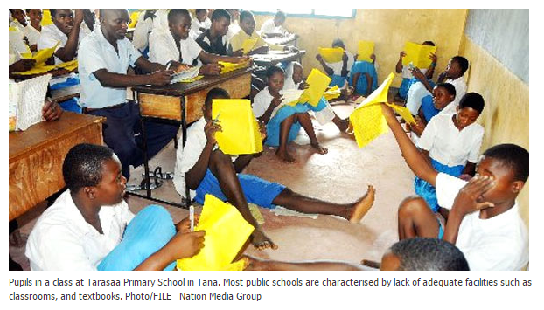

Slide 45
Now let’s see what the MoE, KCID, and IBE-UNESCO think needs reforming
We now pick the main points out of two recent major curriculum reform documents
December 2015 and May 2016
… and add perspective, comment, etc

Slide 46
But first ~
So now, let’s see what YOU think could be changed system-wide to raise the quality of education in Kenya
Group Task 1
With a partner, In five minutes,
Write down the three changes you agree are most important to raise the quality of public education in Kenya

Slide 47
Now pairs join another pair to make groups of four
Work out your new consensus
We report and generalize our results briefly
QUESTION: How many groups mentioned “lack of a competence approach” to be highly importance?
And yet we hope to persuade you that competence is an idea that can embrace many of your concerns

Slide 48
Now let’s see what the MoE, KCID, and IBE-UNESCO think needs reforming
We now pick the main points out of two recent major curriculum reform documents
December 2015 and May 2016
… and add perspective, comment, etc

Slide 50
DOCUMENT 2
Unpublished, IBE, 2016

Slide 51
Some of this parallels the news stories Some of it is new
But, in addition to whining, they propose an alternative to the current and problematic situation
Alternative is known as “CBE”
Competency Based Education
Which (in principle) is a concept broad yet detailed enough to encompass all these problems

Slide 53
Drop Out Problem
Only 30% of the age cohorts complete junior secondary education
Only 12% complete the full secondary cycle
World Bank (2007)

Slide 54
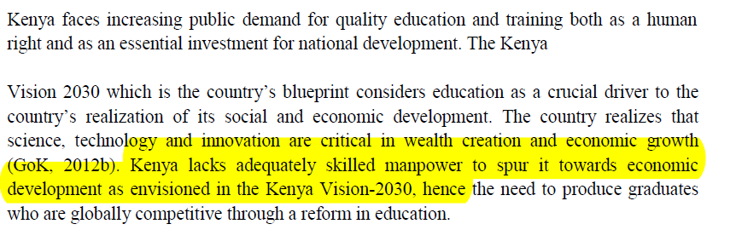

Slide 55
Lack of Skilled Manpower
Kenya lacks adequately skilled [globally competitive] manpower to spur it toward economic development as envisioned in the Kenya Vision-2030

Slide 56
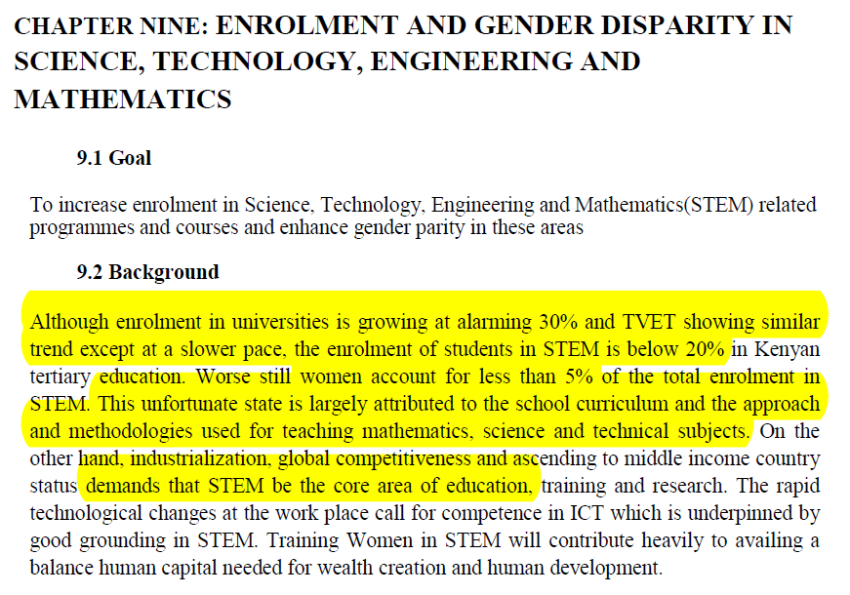

Slide 57
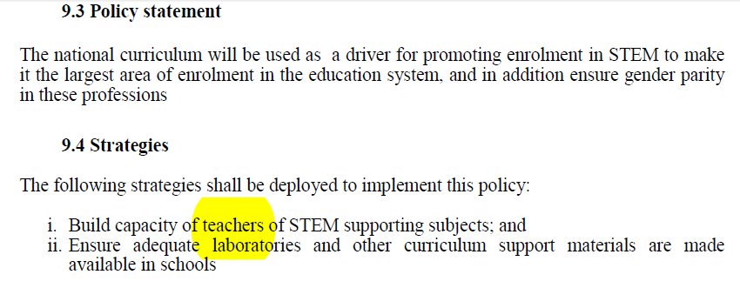

Slide 58
Enrolment: Gender and STEM (2)
Policy: “National curriculum will be used as a driver for promoting enrolment in STEM to make it the largest area in education”
How:
Build capacity of STEM teachers
Invest in adequate laboratories and other resources
Through PPPs?
Private-Public Partnerships

Slide 59
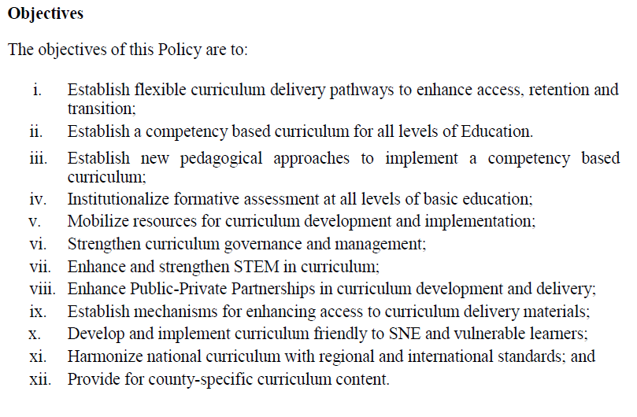
This is probably close to enough new materials for today

Slide 61
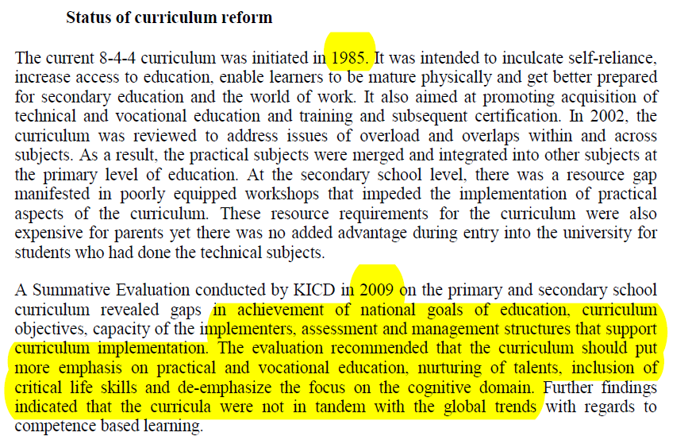

Slide 62
HISTORY: Ongoing Series of Reforms (1)
8-4-4 Curriculum (1985) GOALS
recommendation by the Mackay commission of 1981
Improved access
Better preparation for the world of work
More vocational and technical
Courses combined, overlaps eliminated
Practical merged with other subjects
→ RESULTING IN a more self-reliant learner
BUT
Poorly resourced workshops
S’s with practical/technical did not get into university

Slide 64
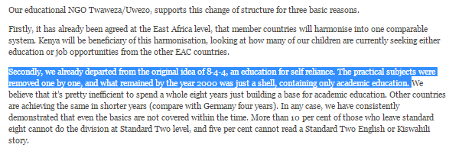

Slide 65
KICD’s summative evaluation (2009) of the 1985 reform found…
Gaps at all levels
Particularly regarding vocational/practical and preparation for the world of work
And critical life skills
Main recommendations were:
More emphasis on practical/vocational
Less emphasis on the focus on the purely cognitive domain
Bring curriculum into tandem with the global trend toward competence-based learning
Which states and assesses expected competencies at every level of learning
Which specifically prepares learners for the world of work

Slide 66
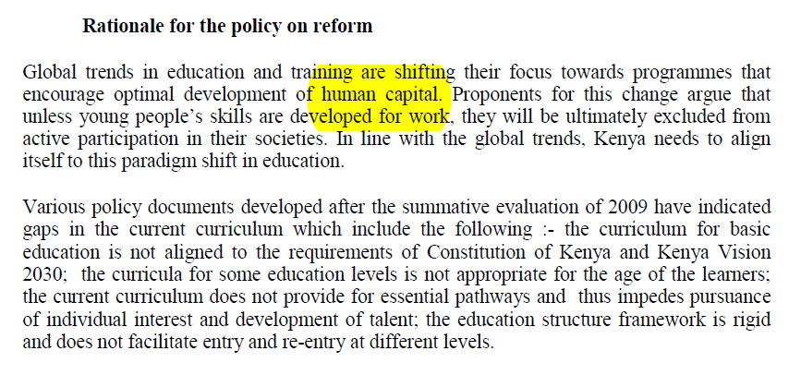

Slide 67
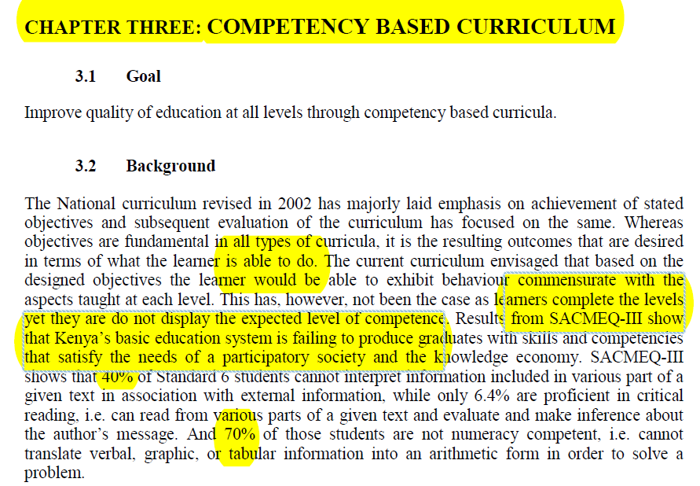

Slide 68
A Competency Based Curriculum
Focuses on what the learner can do not just on what s/he knows
Exhibit behaviour commensurate with what has been taught
Yet there are big problems currently on the “do side”

Slide 69
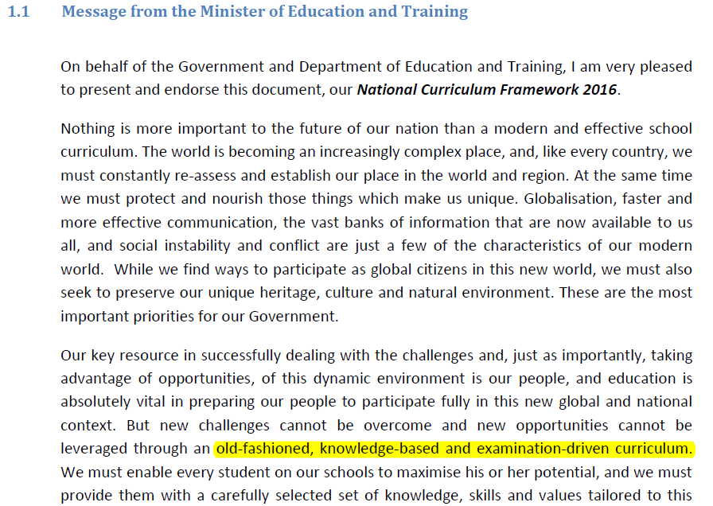

Slide 70
Message from Minister
World of new (1) opportunities and (2) challenges
Importance of education to exploit the opportunities
BUT “…. New challenges cannot be overcome and new opportunities cannot be leveraged through an old-fashioned, knowledge-based and examination driven curriculum.”

Slide 71
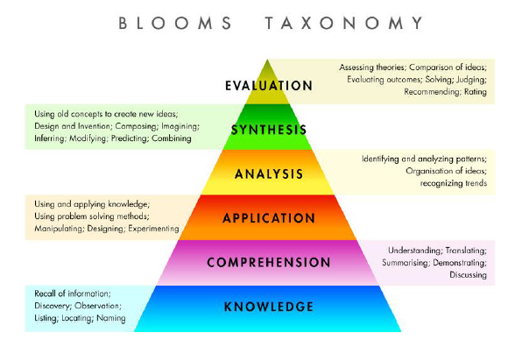
Knowledge, yes, but it is only Step One

Slide 72
R
O
U
G
H
G
U
I
D
E
T
O
K
E
Y
W
O
R
D S
6. Evaluation: appraise, argue, assess, attach, choose compare, defend estimate, judge, predict, rate, core, select, support, value, evaluate
5. Synthesis: arrange, assemble, collect, compose, construct, create, design, develop, formulate, manage, organize, plan, prepare, propose, set up, write.
4. Analysis: analyze, appraise, calculate, categorize, compare, contrast, criticize, differentiate, discriminate, distinguish, examine, experiment, question, test.
3. Application: apply, choose, demonstrate, dramatize, employ,
illustrate, interpret, operate, practice, schedule, sketch, solve,
use, write.
2. Comprehension: classify, describe, discuss, explain, express, identify, indicate, locate, recognize, report, restate, review, select, translate,
1. Knowledge: arrange, define, duplicate, label, list, memorize, name, order, recognize, relate, recall, repeat, reproduce state.

Slide 73
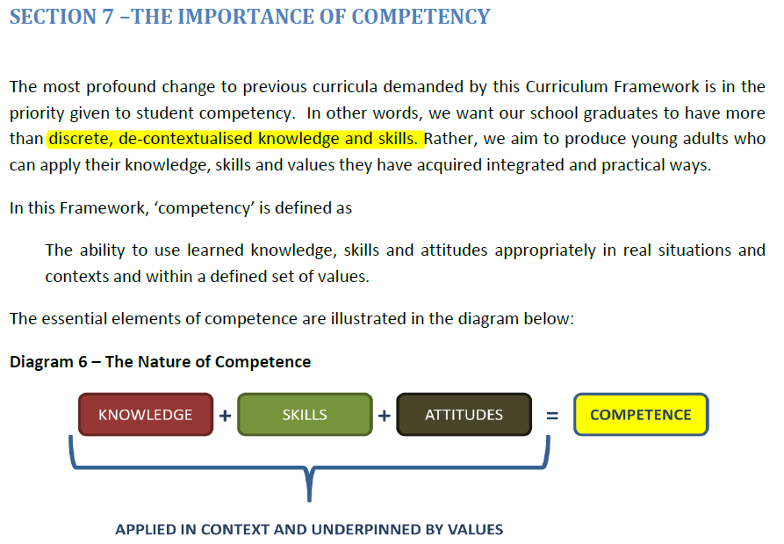

Slide 74
Three big ideas in this diagram
(1) Not knowledge alone
+ skills
+ attitudes
(2) Applied
(3) In context
(4) Underpinned by values
Let’s unpack each of these

Slide 75
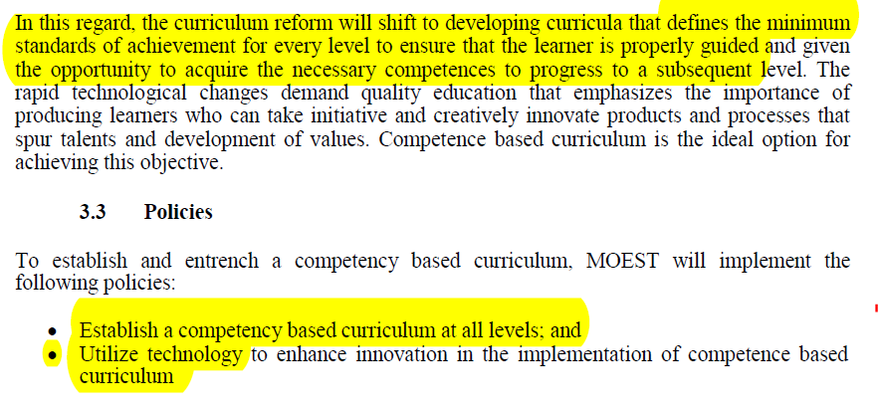
Competency as an ideal opportunity and framework to implement technology

Slide 76
A Competency Based Curriculum (2)
MOEST will assure that learners do not move to the next level until they can perform at the current level
At all levels from primary to secondary
And this will involve information technology at its heart
Not at its periphery, i.e. not “a frill”

Slide 77
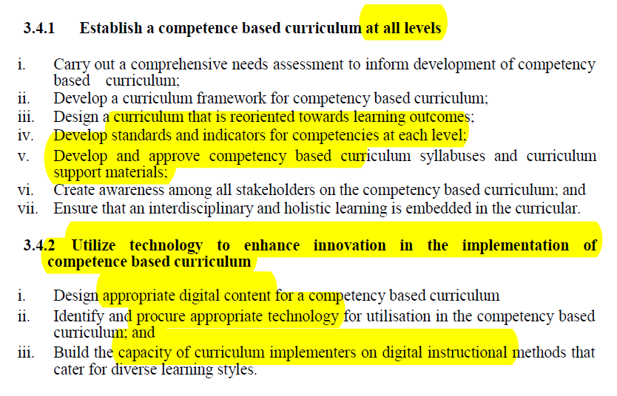

Slide 78
A Competency Based Curriculum (3)
The Reform Process:
Needs assessment →
Curriculum design →
Outcomes, standards and achievement indicators at each level
This is where we are at NOW
Then
→ develop CBE syllabus for each subjects
→ Instructional materials development
→ make stakeholders aware of all this
→ capacity building of teachers and trainers
→ Finally PILOTING (Jan 2017)
→ National Roll-Out and Implementation (2018-19 depending on results)
→ FINALLY Monitoring and Evaluation (M&E)
= Formative evaluation
→ Starting Gr 1 and ECD

Slide 79
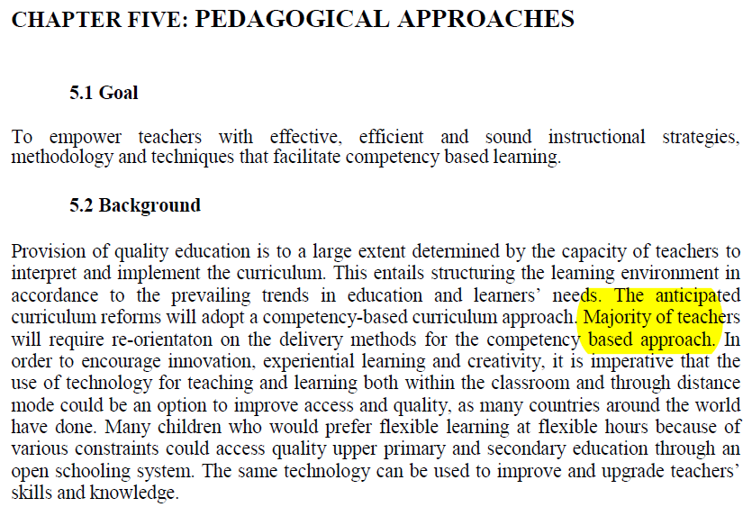
HOW WILL ALL THIS AFFECT TEACHING?

Slide 80
Pedagogical Approaches
“The majority of teachers will require re-orientation on the delivery methods for the competency based approach”
We need to “empower teachers with effective, efficient, and sound instructional strategies, methodology and techniques that facilitate competency based learning”
through new degree and diploma content
through professional development programs
through In-service training

Slide 81
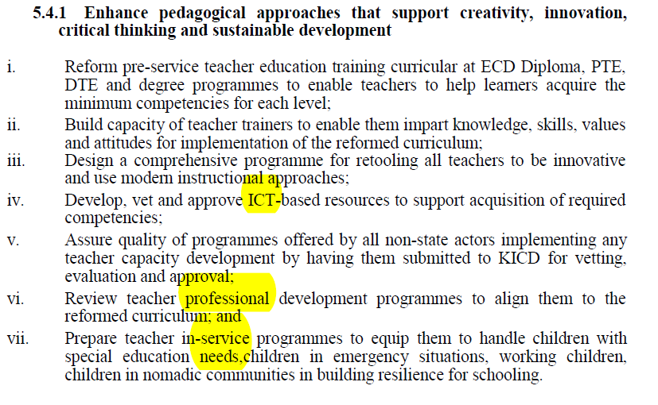

Slide 82
BACK TO THE IBE DOCUMENT (2016) Now what teachers will be expected to do with all this

Slide 83
CA and teaching strategies, methods, learning materials
What is a CA teaching method?
What sort of manuals are needed for CA?
Are manuals actually needed at all?
The alternative to manuals
Adapting manuals
Re-conceiving manuals
Key role for the activated learner
Effective preparation for group discussion and reporting

Slide 84
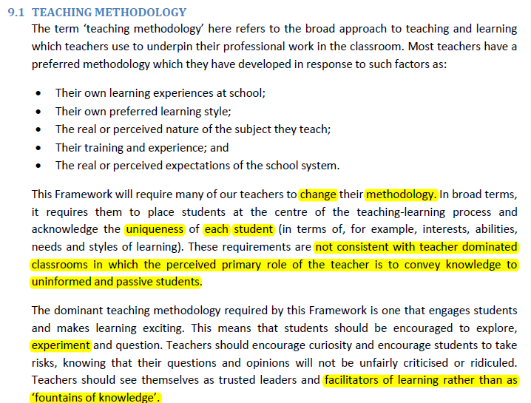

Slide 85
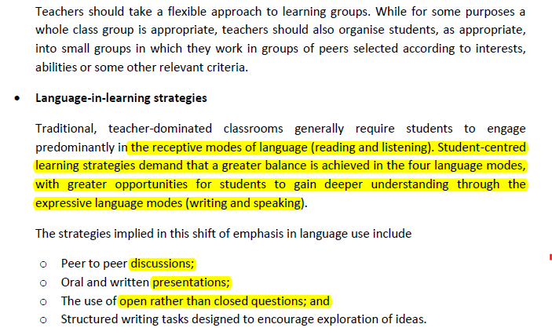

Slide 87
CA-friendly Teach strategies/methods/materials
“LEARNER CENTRED”: What does it really mean?
Use more real than display questions
Let learners have at least 50% of the talk time
To each other
To the teacher
Which means making sure they have been given something worth saying
Given → Led toward

Slide 88
Learner centred
Try to TELL less
SHOW more and let learners discover something and TELL YOU
A.k.a. “activity based” approach
Give them data and let them find the “pattern” or “rule”
‘bottom up,’ ‘inductive,’ ‘discovery,’ or problem solving

Slide 89
Example from Language Learning
COLLOCATIONS
Should we explain that we say “drive a car” but “ride a bicycle” or “ride a horse”

Slide 90
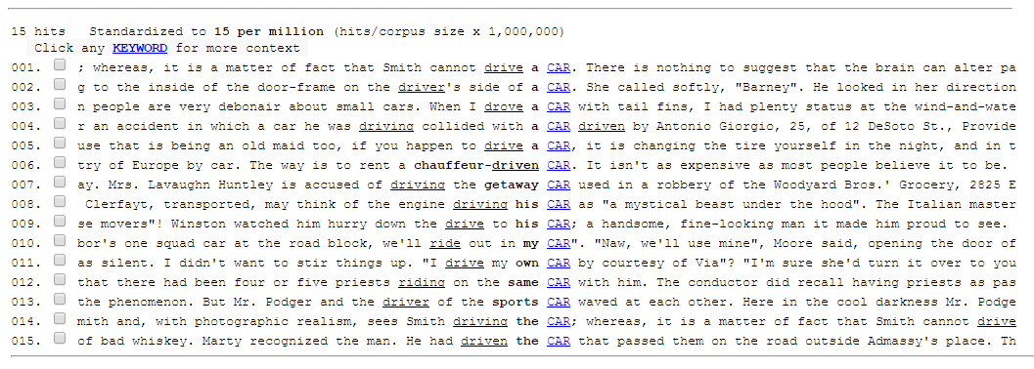
Or let them ‘discover’ it

Slide 91
Problem Solving
This is a “core competence” in most North American CA systems
More on this on Day 2
The basic idea:
A ‘problem’ is a problem because it is
Novel, never seen before in exactly this format
Ill defined
WE HAVE NO PRIOR RULES FOR HOW TO PROCEED
THEREFORE we must combine knowledge, skills, resources, imagination from many areas to solve it

Slide 92
Alberta (Canada) version of this has 8
KENYA 1 Technology
2 Communication
3 Analysis and synthesis
4 Creative Thinking
5 Problem solving
6 Working with others

Slide 93
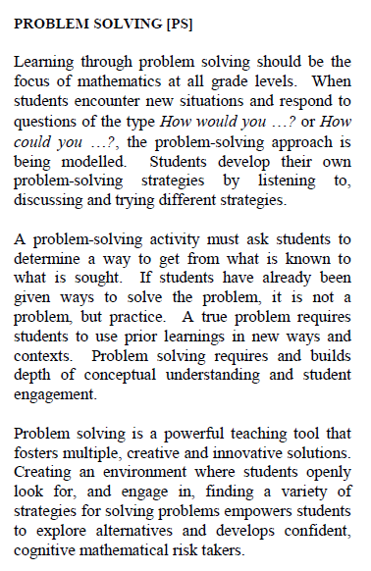
Also elaborated at length, e.g. problem solving … and compared to what it is NOT
From POS k-9 math

Slide 94
In fact…
Almost all problems that are interesting and important are ‘ill defined’ and cannot be solved by the application of known rules/procedures
Poverty reduction
Integration of the homeless back into society
Gender equity

Slide 96
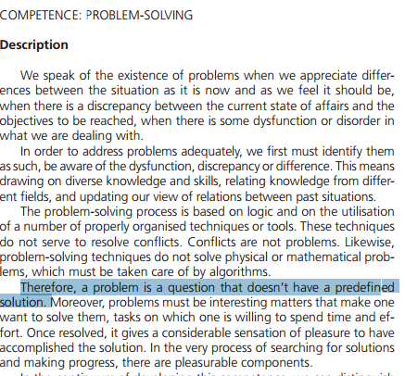

Slide 97
Problem solving skills vs knowledge of fixed content

Slide 98
Why problem solving?

Slide 99
Problem solving in different disciplines
SCIENCE
At least there is a problem solving toolkit
LITERATURE: WRITE A POEM ABOUT LOVE
What are my tools?

Slide 100
Problem solving and workplace preparation
What sorts of jobs do we want our learners to get?
EMPLOYERS LIST PROBLEM SOLVING ABILITY AS THEIR TOP REQUIREMENT
OVER MATH AND LITERACY!

Slide 101
Problem solving and economic development

Slide 102
Learning opportunities of problem solving
Put it all together
As never seen before
Exercises the imagination

Slide 103
Issues in assessing the success of problem solving
You tell me

Slide 104
All of these involve features of relevance to learners’ lives
AND also involve problem solving
They do not simply ask for an answer to a problem type that has been seen before
But rather ask for a new application of concepts that have been taught or seen before

Slide 105
FIVE GROUPS BY PRIMARY SUBJECT
Maths | 6
Science | 9
English | 11
Social Studies | 9
Kiswahili | 11
After lunch
Bring me a list of names for each group
Tomorrow please sit together
Look for PDFs or Mobile images of a current textbook task, etc. (3 pp. max)

Slide 107
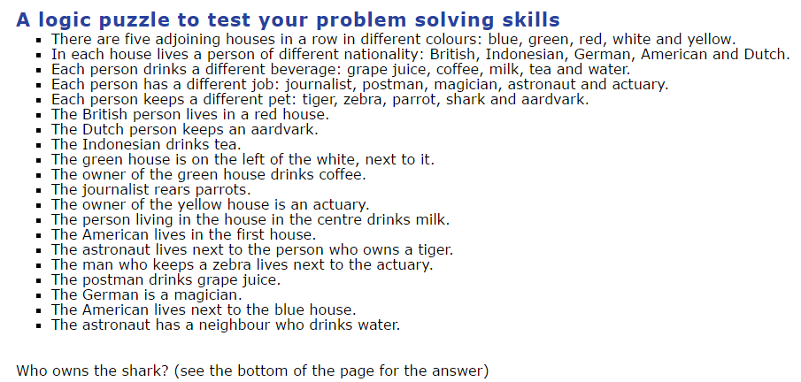
Example

Slide 108
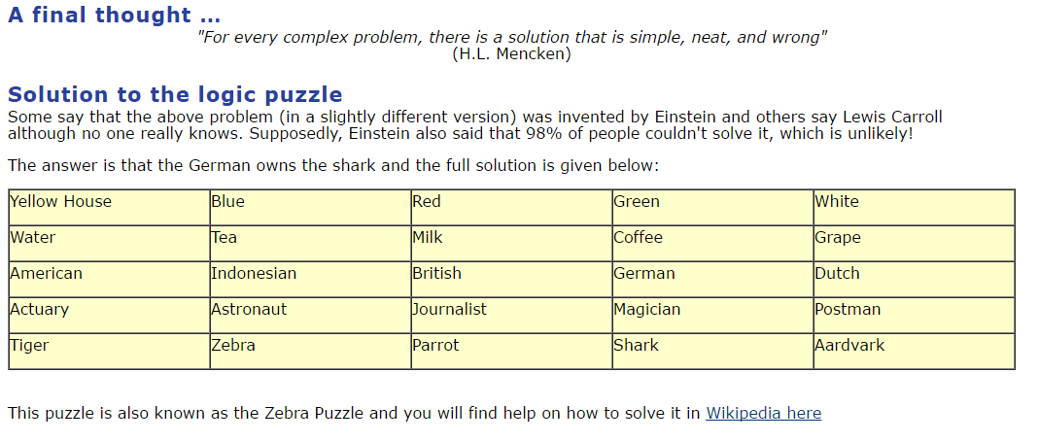
http://en.wikipedia.org/wiki/Zebra_Puzzle

Slide 109
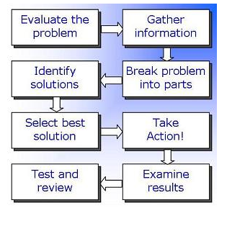
Below is a typical problem solving process that can guide students efforts (after they are shown how to use it – see a great example from primary Math in the Youtube)
https://www.youtube.com/watch?v=f2qOJw54iQo

Slide 110
Only for Older Students? They don’t get much younger than these kids – who are learning how to do word problems in Math in New York City
https://www.youtube.com/watch?v=CypcbWQ5ix4

Slide 111
Issues in assessing the success of problem solving
Sometimes there is not a standard answer
ALWAYS there is not a standard method
Two students may have the same answer
Success of the solution could be somewhat subjective
“Brilliant!” To one teacher, “Crazy!” To another

Slide 112
NOW YOU: Develop or adapt a problem solving activity in your subject group
The rubric for the student
What knowledge is needed (from your course or elsewhere)
Performed by group or individual?
Is there “an answer”?
What is the time frame?
How much is teacher involved?
How could it be assessed? (Form’ly + Summ’ly)

Slide 113
ASSESSMENT in cbe
New topic

Slide 114
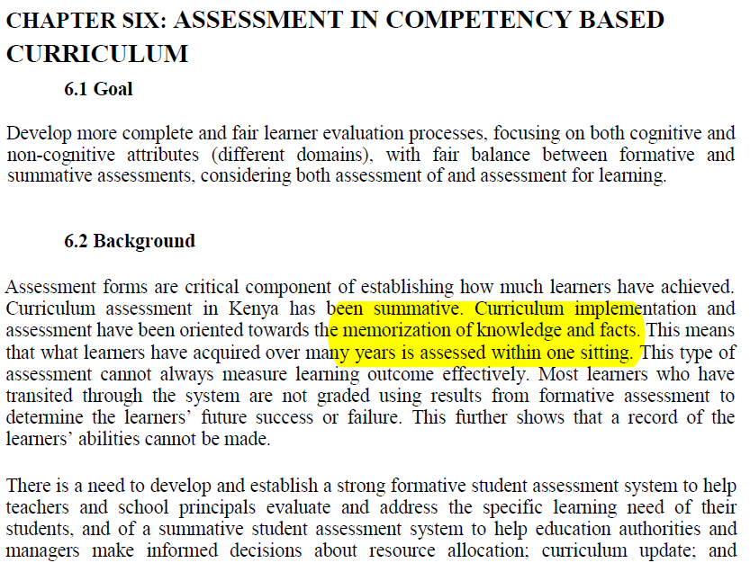
KICD

Slide 115
Competency-Based Assessment
Main idea:
NUMEROUS forms of assessment must be used
Less focus on memorization of knowledge and facts
Much less focus on big, “one-sitting” examinations where everything in a course is tested at the same time

Slide 116
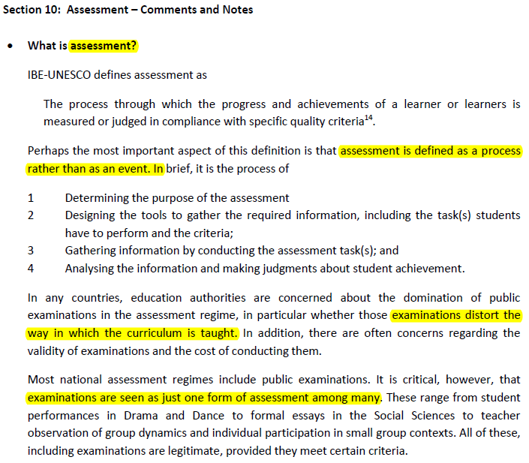
IBE

Slide 117
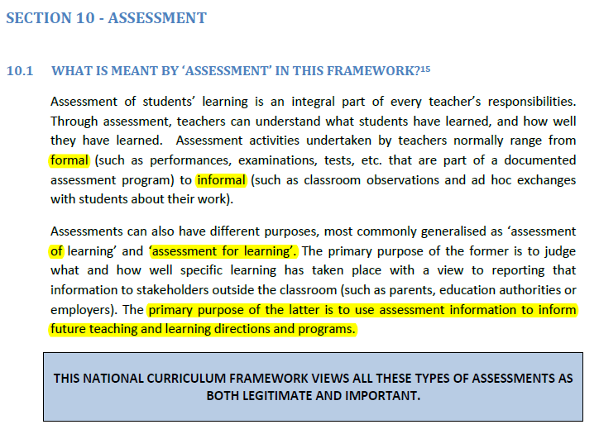

Slide 118
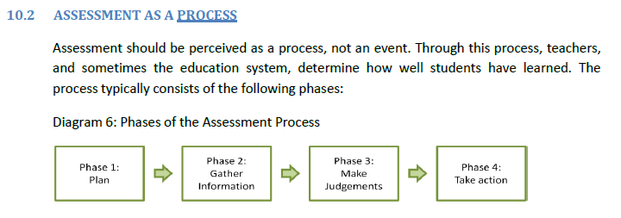

Slide 119
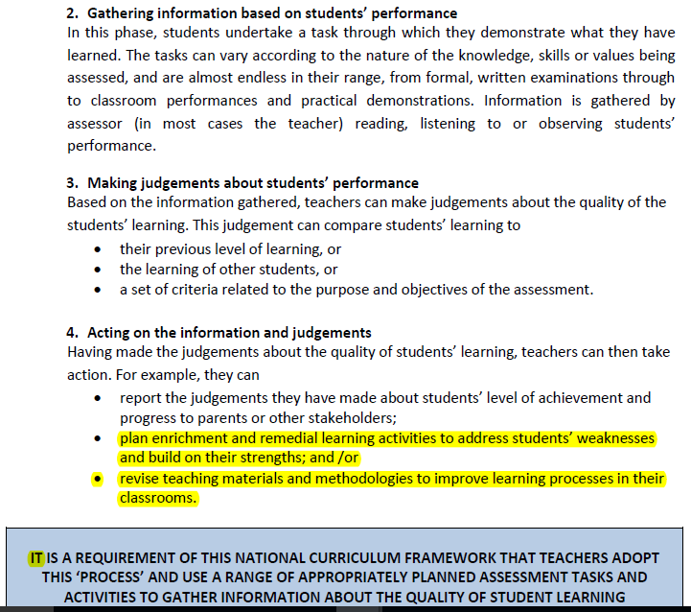

Slide 121
Was that faraway, examination-obsessed China? Then look at this instead

Slide 122
How can “application of knowledge” be tested in such a setting?
This setting is good only for testing “knowledge per se”
Which quickly degenerates into the testing of rote knowledge

Slide 123
Can “application of knowledge” be fit into these little multiple-choice boxes? “Kenya is an examination system, not an education system” Dr Andrew Riechi, Dept of Educ, Univ. of Nairobi

Slide 124
Interesting discussions about TESTS from our last visit to KICD
Attended mainly by KICD curriculum developers
SOME CONCLUSIONS FROM THESE DISCUSSIONS

Slide 125
2 Visit from KICD Testers
We sat in domain groups and prepared a BRIEF review of
‘AS WE TEST NOW vs HOW WE SHOULD TEST IN A COMPETENCE APRROACH’
To present to the testers
Who never arrived but
A useful exercise anyway

Slide 126
Our Main Conclusions
Obstacles to a competence approach (CA) in Kenya are often to do with existing modes of testing which are not competence oriented
Formative assessment is missing or ignored
Ss’ assessment remains:
a) pass-fail at the end
b) largely knowledge based

Slide 127
MORE conclusions 2
Testing will drive any curric reform: teachers will adjust their behaviour only when they see what is on the tests that measure success.
No real change in testing = no real change in curriculum
CA inherently and logically requires a lot of Formative Assessment, because knowledge application takes time and cannot be tested in a 3-hour summative
Esp since the psych-social dimension requires cooperative group work which cannot be included in 3-hr test
Although difficult, a way MUST be found to incorporate real Formative Assessment into final judgments of learner success

Slide 128
Conclusions 3
Curriculum is so jammed full that
There is rarely time to stop and work out the or application or use for any new knowledge that Cbe proposes
If formative assessment shows that any part of our teaching has failed for the majority of Ss, there is no time to fix and repeat this instruction
Formative assessment is rarely used even to give concrete feedback to the learner

Slide 129
Findings 4
A lot of the work Ss are doing in many domains is rather competence oriented already, in many interesting ways
But this is not reflected in the largely summative-only, knowledge-only testing

Slide 130
Findings 5
Formative assessment is a vital part of a learner-centered, competence approach,
Canada only gives 30-50% to the final summative assessment, ALL the rest is formative
Kenya plans something similar, as seen on Day 1
But the problem: it is not clear teachers are able or willing to be impartial in their formative assessments
Is this a teacher training issue?
Is there a risk of corruption?
Or is it a “there are no strict criteria for marking” issue?
Would double marking + clear criteria do the job?
Is a Quality Control Program the answer ?

Slide 131
Findings 6
Learners often fail tests because they cannot read the question correctly
Is there any solution to this?
Math, science, etc
Let’s look at a solution from Lextutor sometime
www.lextutor.ca/vp/
Will be my contribution on presentations day

Slide 132
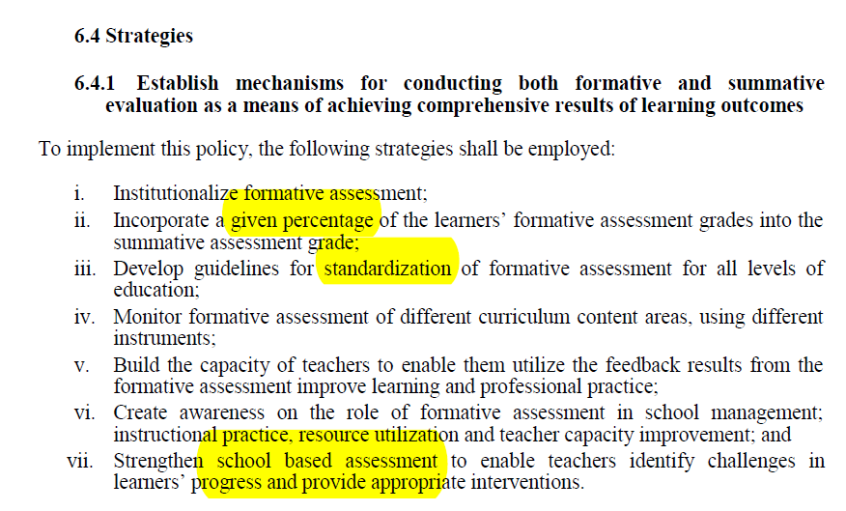
So what is the alternative?

Slide 133
Competency-Based Assessment (2)
More focus on formative, less on summative
This has to be institutionalized
This has to be standardized for subjects and levels
This has to be monitored for fairness
A given percentage of the final grade to be derived from formative
But teachers must be trained to use formative assessment to improve learning
Modify interventions
Determine where change of pedagogical strategy is required

Slide 134
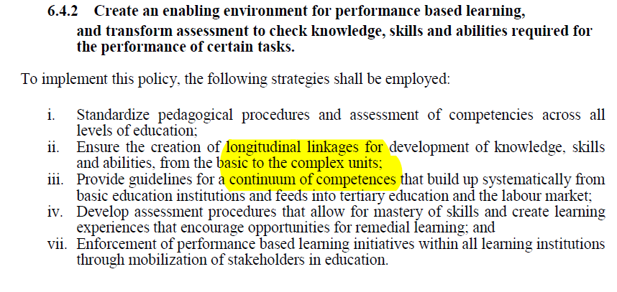
→ All this means an “environment” of changes,” not one change

Slide 135
Competency-Based Assessment (3)
In each subject, we test a “continuum of competencies” (i.e. test the same competency at increasingly complex levels)
… from basic through to tertiary or vocational
Use both formative and summative assessment to drive a mastery-and-remediation approach

Slide 136
Formative: one promising idea is portfolio based assessment

Slide 138
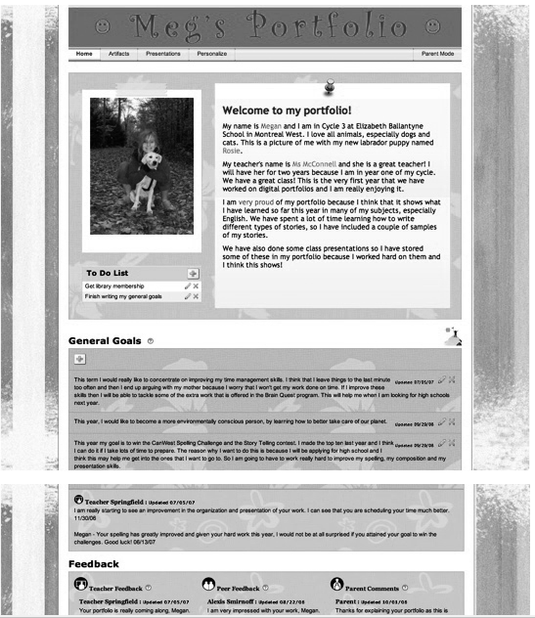

Slide 139
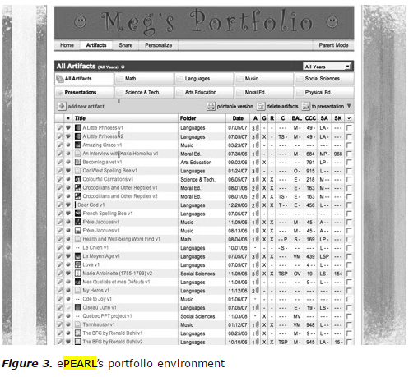

Slide 140
However we do it, if we want this…
… then we can not assess for the first part only (knowledge)
Because testing will drive the curriculum whatever else KICD says

Slide 141
Exercise: Re-write typical knowledge objectives as competences

Slide 142
These are actual objectives from a recent version of Kenya’s curriculum

Slide 143
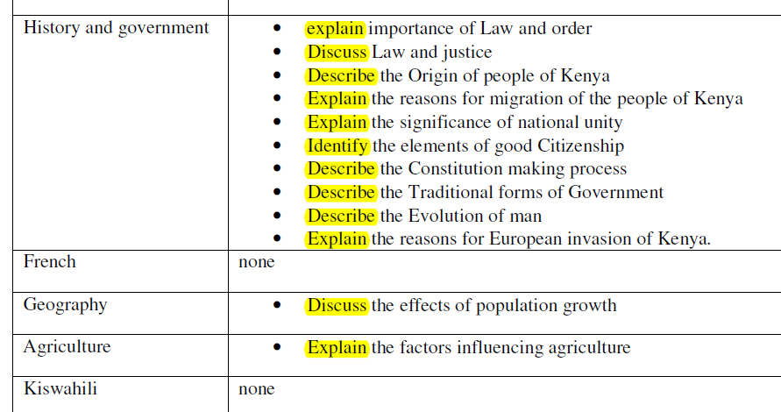

Slide 144
These are CBE-oriented objectives from Alberta Canada
What main differences do you see?
https://education.alberta.ca/media/159597/program-of-studies-grade-6.pdf

Slide 145
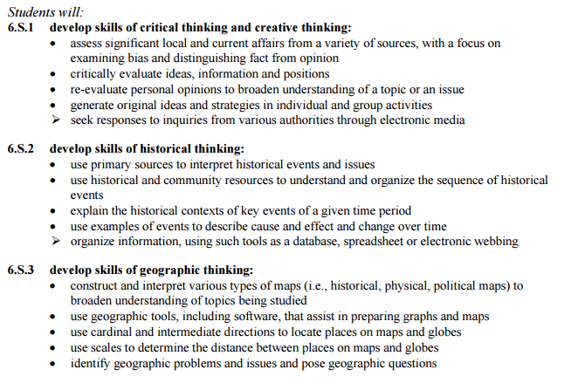

Slide 146
Main differences
A broader variety of VERBS describing what students are meant to do
And, these verbs are not all ‘cognitive’ verbs (explain, etc) but more often ‘do’ verbs (use…)
Many of the objectives involve not only knowing something but also using this knowledge
“use geographic tools and software to prepare maps”
“use primary sources to interpret historical events and issues”

Slide 147
Your Task
With a partner
Choose ONE of the Kenyan objectives and re-write it
With a more active verb
Stating a use for this knowledge
I will show the Kenyans PPT for you to choose and write down
Then change to the Canadian PPT to use as a model
NEXT WE ADD A SITUATION → YES

Slide 148
Drilling down into the competency concept
REVIEW: what do we know so far about CBE?
(competency based education)
As we go around, everybody add something

Slide 149
Topics to be discussed at the end of this presentation
CBE and the CORE COMPETENCIES

Slide 150
DOCUMENT 2
Unpublished, IBE, 2016

Slide 151
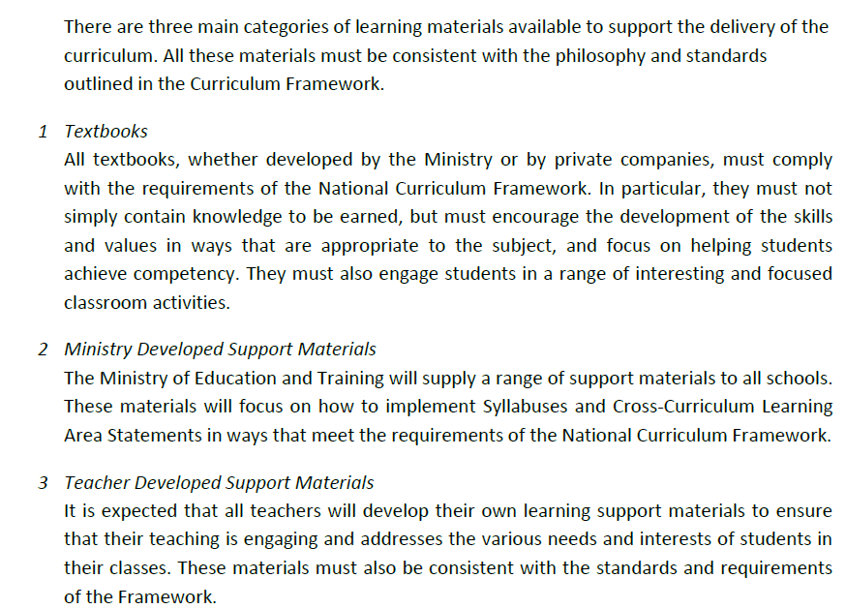

Slide 152
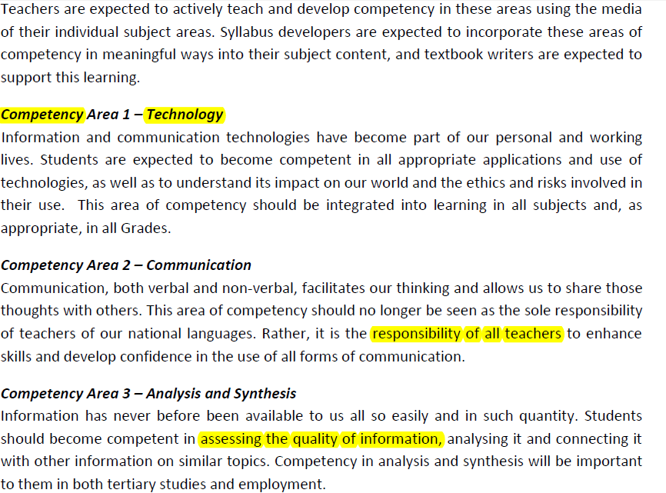

Slide 153
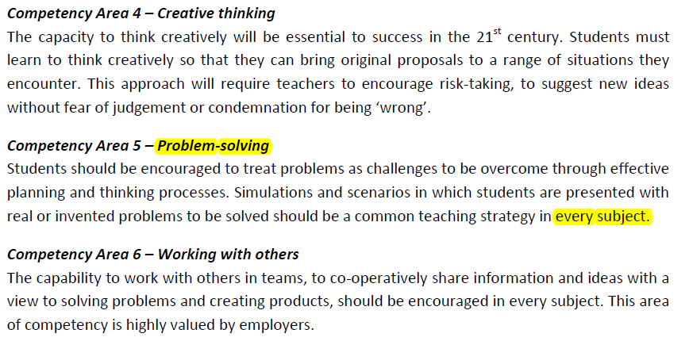
Let’s compare these with an alternate version of the “core competencies” in a Canadian context →

Slide 154
SO the “core/transversal/cross-curricular” competencies are:
1 Technology
2 Communication
3 Analysis and synthesis
4 Creative Thinking
5 Problem solving
6 Working with others
+7 Learning to learn

Slide 155
Alberta (Canada) version of this has 8
KENYA 1 Technology
2 Communication
3 Analysis and synthesis
4 Creative Thinking
5 Problem solving
6 Working with others
7 Learning to learn

Slide 156
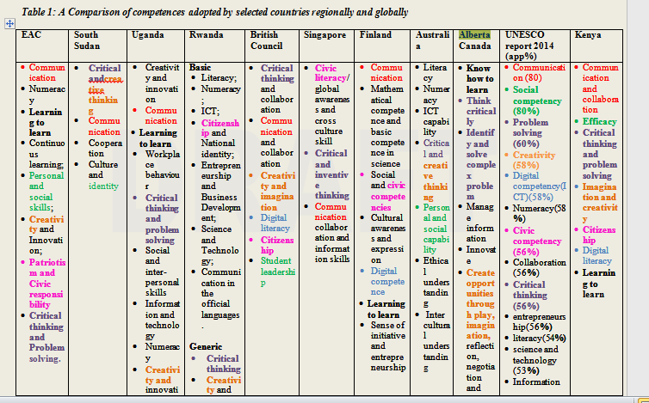
From KICD, Draft Curriculum Final, 2016

Slide 157
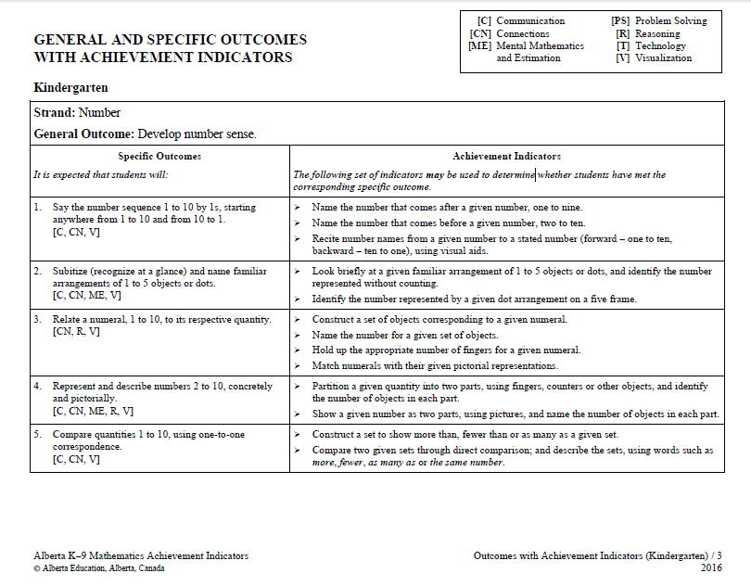
Then, in addition to these, subjects have their own core competencies
E.g. Alberta’s kindergarten math

Slide 160
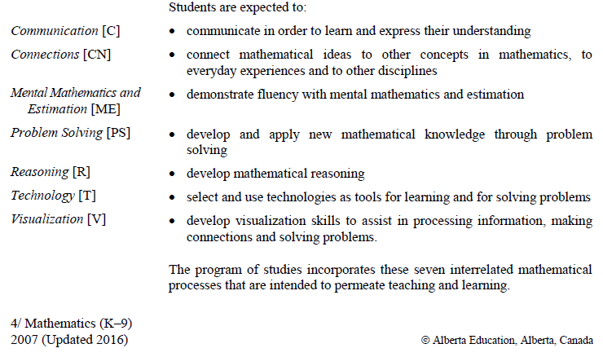
And each one defined →

Slide 161
Also elaborated at length, e.g. problem solving … and compared to what it is NOT
From POS k-9 math

Slide 162
Same competencies recur over the levels in increasingly complex forms

Slide 163
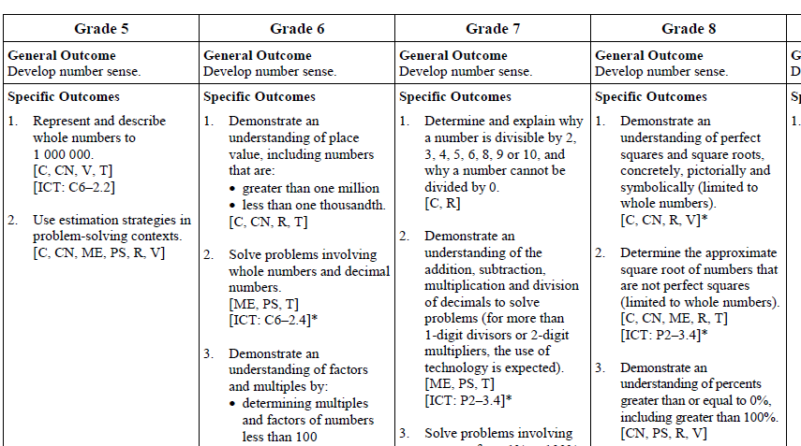
Same competencies recur over the levels in increasingly complex forms

Slide 164
In other words…
The competencies allow us to organize education in a tightly organized spiraling hierarchy
Where the same content is repeatedly revisited at an ever more complex level
SKIP TO P. 51 for the re-writing objectives as competencies exercise

Slide 165
Testing is the end point in a long process
The first step is to write OBJECTIVES that force the test writer to include more than simply knowledge
This is the exercise that got postponed from yesterday

Slide 166
Reminder!
Send me your textbook lesson (PDF or Mobile-Phone image, max three page) before you leave, if possible
Or before tomorrow morning, latest
cobb.tom@sympatico.ca

Slide 167
16h30 – 17h
Tea/coffee break End of Day 1

