Slide 1
KICD – UNESCO – IBE Curriculum Workshop Day 2, AM September 2016
Thomas Cobb Faculty of Education, Université du Québec à Montréal Lili Ji
International Bureau of Education
Geneva

Slide 2
This is an example of “the learner-centered classroom”
The teacher does not INSIST on his/her lesson plan
A spontaneous learning opportunity presents itself and is accommodated
The lesson plan can wait

Slide 3
Let’s start with another KICD reform document
As
(1) a review and further specification of new ideas presented yesterday
PLUS
(2) some specifics about the teaching strategies that go along with a competence approach
AND
(3) some ideas from Canada about CBE
REMEMBER - That we have a small quiz toward the end of this day

Slide 4
Implication topics to be discussed at the end of this presentation
CBE only for city schools?
CBE only for science subjects?
CBE only for older or gifted learners?
CBE only for intact classrooms? CBE and teaching methods
CBE and the CORE COMPETENCIES
CBE and the importance of “situated learning”

Slide 5
DOCUMENT 2

Slide 6
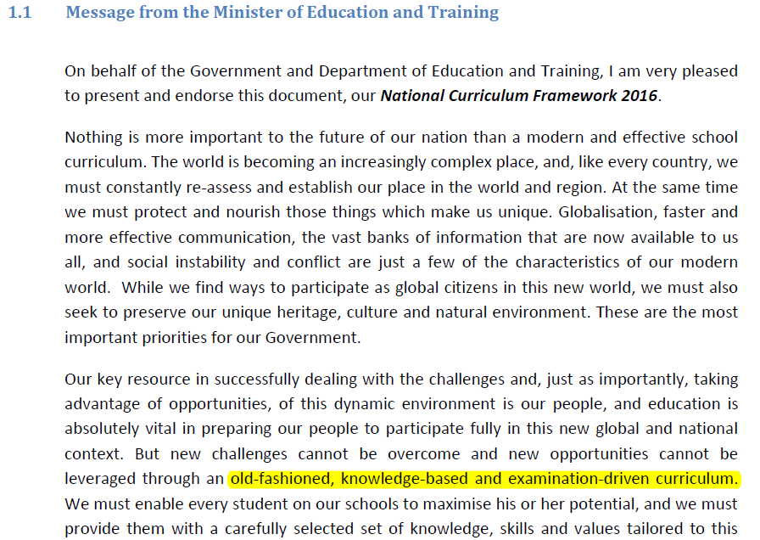

Slide 7
Message from Minister
World of new (1) opportunities and (2) challenges
Importance of education to exploit the opportunities
BUT “…. New challenges cannot be overcome and new opportunities cannot be leveraged through an old-fashioned, knowledge-based and examination driven curriculum.”

Slide 8
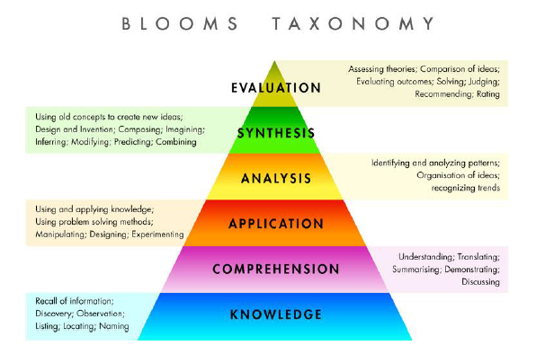
Knowledge, yes, but it is only Step One

Slide 9
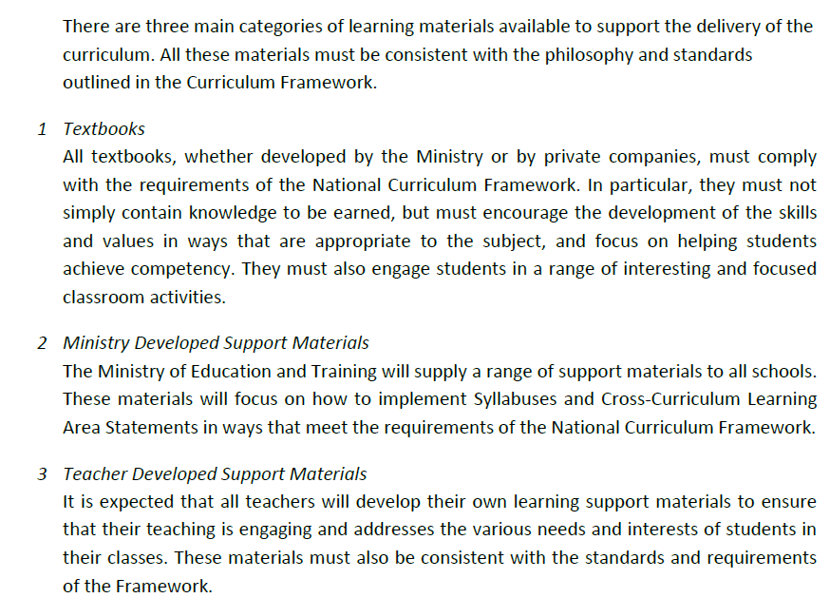

Slide 10
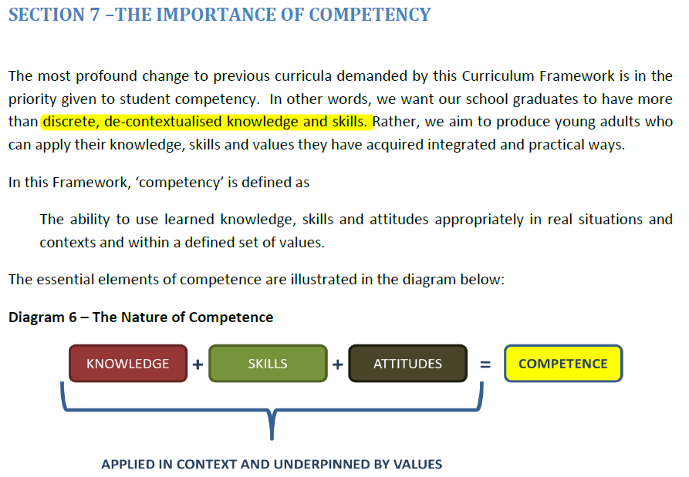

Slide 11
Three big ideas in this diagram
(1) Not knowledge alone
+ skills
+ attitudes
(2) Applied
(3) In context
(4) Underpinned by values
Let’s unpack each of these

Slide 12
A bit unclear. I would add
These are cross-curricular competencies that feature within and across subject areas and follow throughout the years
of schooling at increasingly complex levels

Slide 13
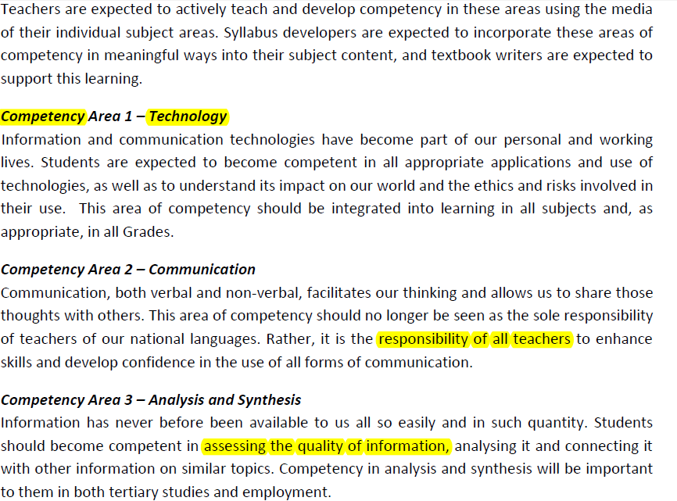

Slide 14
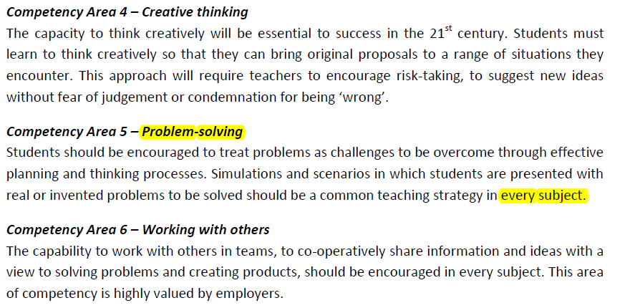
Let’s compare these with an alternate version of the “core competencies” in a Canadian context →

Slide 15
SO the “core/transversal/cross-curricular” competencies are:
1 Technology
2 Communication
3 Analysis and synthesis
4 Creative Thinking
5 Problem solving
6 Working with others

Slide 16
Alberta (Canada) version of this has 8
KENYA 1 Technology
2 Communication
3 Analysis and synthesis
4 Creative Thinking
5 Problem solving
6 Working with others

Slide 17
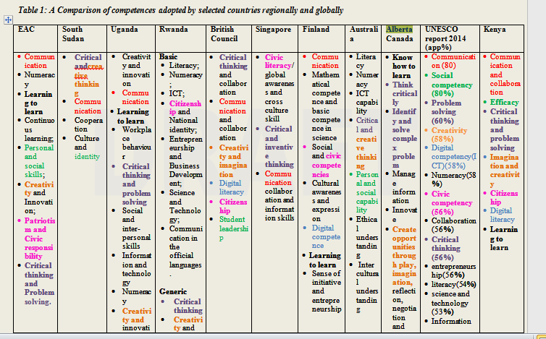
From KICD, Draft Curriculum Final, 2016

Slide 18
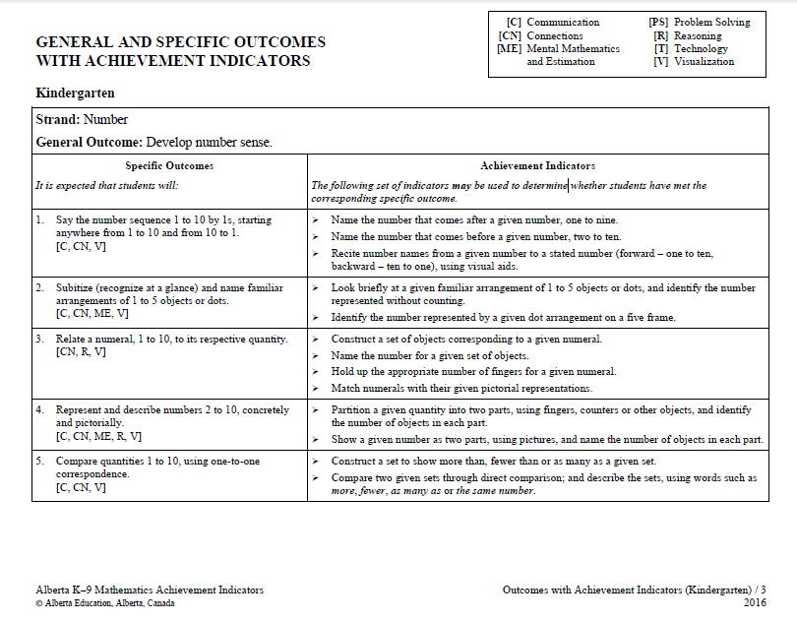
Then, in addition to these, subjects have their own core competencies
E.g. Alberta’s kindergarten math

Slide 21
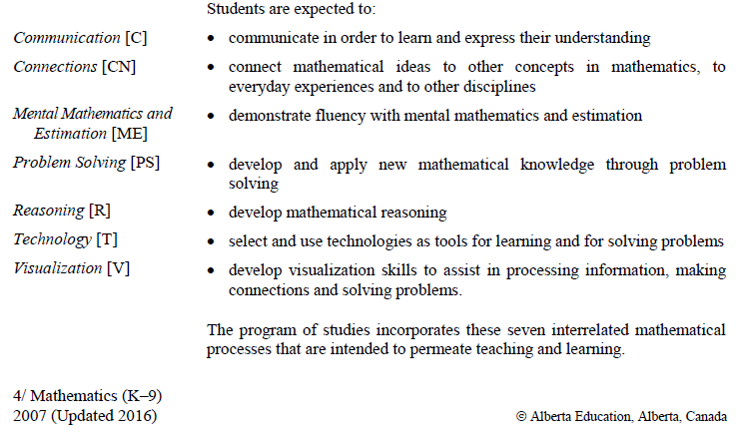
And each one defined →

Slide 22
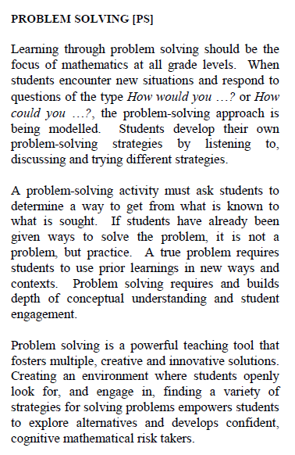
Also elaborated at length, e.g. problem solving … and compared to what it is NOT
From POS k-9 math

Slide 23
10h40 – 11h10
Tea/coffee break

Slide 24
Same competencies recur over the levels in increasingly complex forms

Slide 25
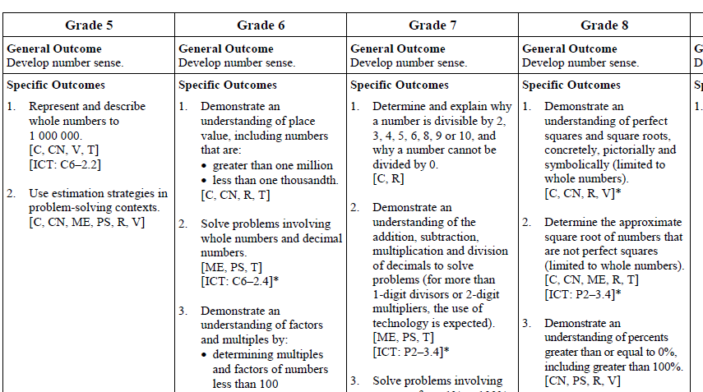
Same competencies recur over the levels in increasingly complex forms

Slide 26
In other words…
The competencies allow us to organize education in a tightly organized spiraling hierarchy
Where the same content is repeatedly revisited at an ever more complex level
SKIP TO P. 51 for the re-writing objectives as competencies exercise

Slide 27
Testing is the end point in a long process
The first step is to write OBJECTIVES that force the test writer to include more than simply knowledge
This is the exercise that got postponed from yesterday

Slide 28
These are actual objectives from a recent version of Kenya’s curriculum

Slide 29
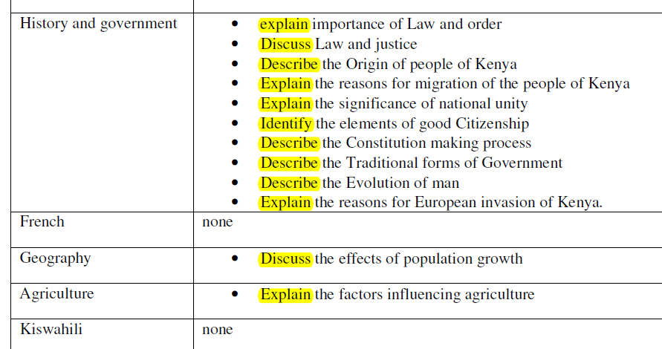

Slide 30
These are CBE-oriented objectives from Alberta Canada
What main differences do you see?
https://education.alberta.ca/media/159597/program-of-studies-grade-6.pdf

Slide 31
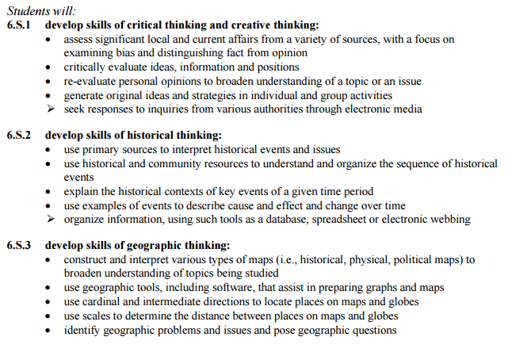

Slide 32
Main differences
A broader variety of VERBS describing what students are meant to do
And, these verbs are not all ‘cognitive’ verbs (explain, etc) but more often ‘do’ verbs (use…)
Many of the objectives involve not only knowing something but also using this knowledge
“use geographic tools and software to prepare maps”
“use primary sources to interpret historical events and issues”

Slide 33
Your Task: Part 1
With a partner
Choose ONE of the Kenyan objectives and re-write it
With a more active verb
Stating a use for this knowledge
I will show the Kenyans PPT for you to choose and write down
Then change to the Canadian PPT to use as a model
NEXT WE ADD A SITUATION → YES
Remember I promised you a small written quiz
Work alone, 40 minutes

Slide 34
NOW ADD CONTREXTUALIZATION
(Or situated learning)
Learning is easier in familiar situations
-→ DEMONSTRATION

Slide 35
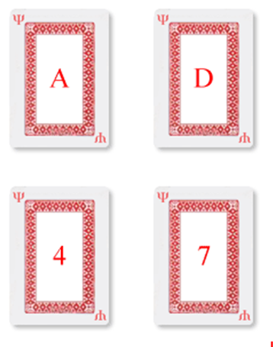
Each card has a letter on one side and a number on the other side.
1 2
What card(s) must be turned over to determine if the following statement is false? If a card has a vowel on one side, then it has an even number on the other side.
3 4

Slide 36
Each card has a drink on one side and the drinker’s age on the other side.
1 2
What card(s) must be turned over to determine if the following statement is false? If a person is drinking beer, then the person is over 19 years old.
BEER
COLA
3 4
16 YEARS
22 YEARS

Slide 37
Great Alberta Questions/tasks WITH LOCAL CONTEXTUALIZATION

Slide 38
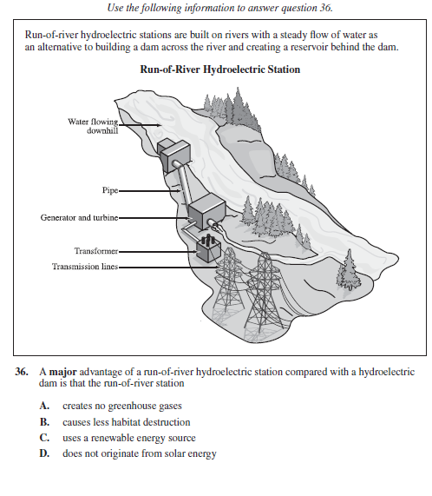
Local relevance – prior knowledge

Slide 39
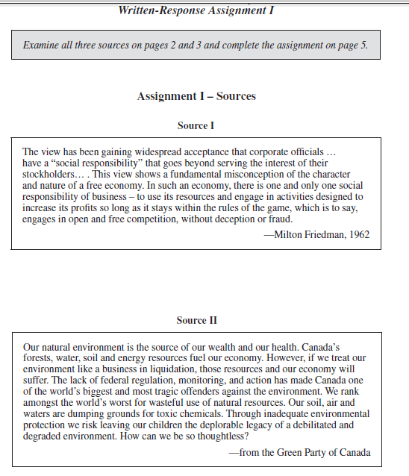
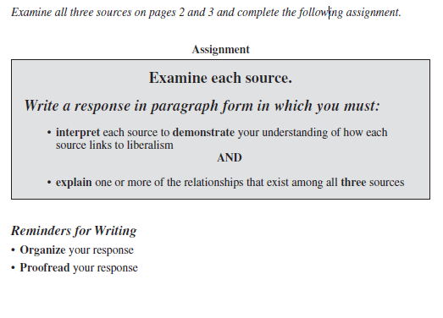
Requires handling new info Gr 10 Social Science

Slide 40
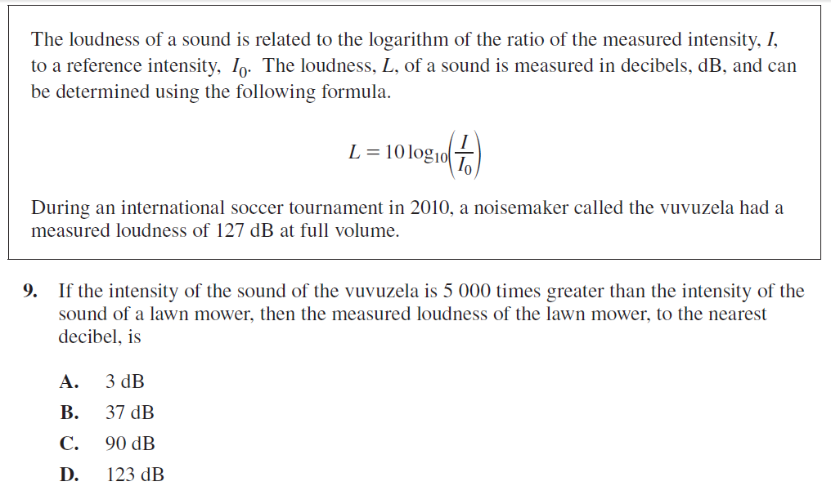
Tap prior knowledge (vuvuzela)

Slide 41
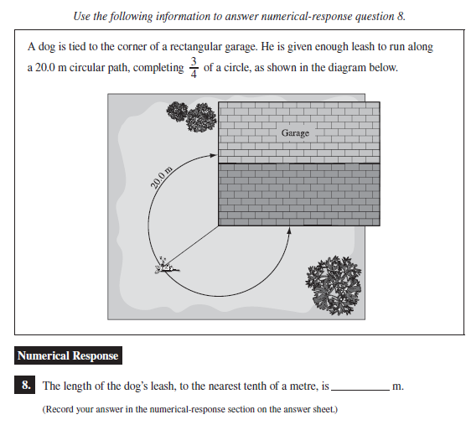
Prior knowledge: pets

Slide 42
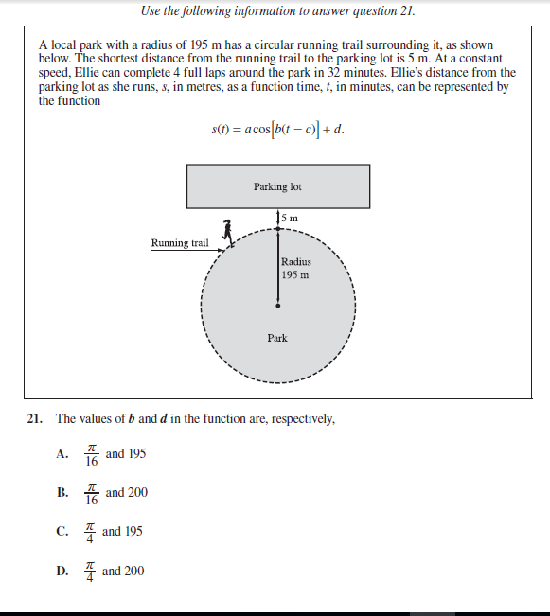
Prior knowledge: running trail

Slide 43
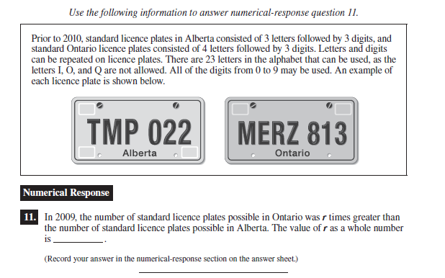
Prior knowledge: licence plates

Slide 44
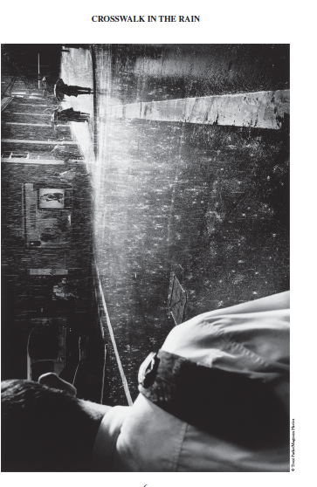
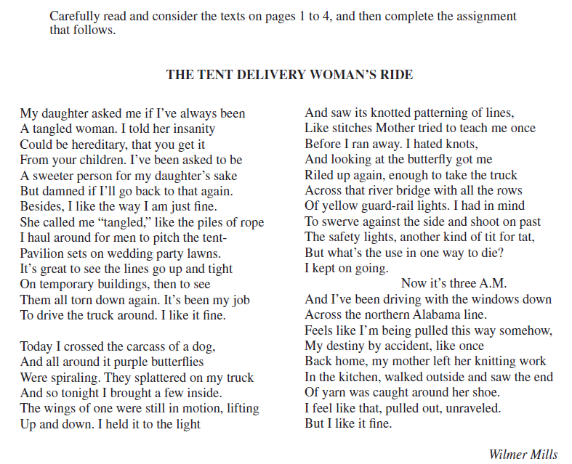
Language Arts

Slide 45
All of these involve features of relevance to learners’ lives
AND also involve problem solving
They do not simply ask for an answer to a problem type that has been seen before
But rather ask for a new application of concepts that have been taught or seen before

Slide 46
But of course…
Localization of materials involves many, many issues
For starters we need to be AWARE of the localization issue
Also called situated effect, contextual effect, familiarity effect

Slide 47
13h – 14h
Lunch

Slide 48
KICD – UNESCO – IBE Curriculum Workshop Day 2 PM
Thomas Cobb Faculty of Education, Université du Québec à Montréal Lili Ji
International Bureau of Education
Geneva

Slide 49
ON THE AGENDA
More on contextualization
Your contributions
More on Testing
The key role of remediation
Assessment of for learning”
Youtube video from major US Professor of CBE
MANY of our themes appear in this discussion
Short Quiz
40 minutes

Slide 50
MORE ON CONTEXTUALIZATION
‘The environment’ is a huge source of teaching materials for teachers who know how to use it
Main or supplementary
Last time we discussed SPORTS STATISTICS in Math
And using money changing in the market place in Niger

Slide 51
Materials 3 (envt.)
In ESL ~
Learner groups go out for 30 minutes and look for 10 new words they d not understand
‘Scribe’ writes down the physical and linguistic context
Back in class
Groups decide on the three words they most need to know (meta-cognition)
Teacher explains, illustrates, dramatizes
Half these words appear in the weekly formative quiz

Slide 52
Materials 4 (envt.)
Montreal ESL Ss have learned some words and sentences for asking directions
Groups of 4 take the train to the end of the line
Must come back on the bus
Have only bus tickets and a tape recorder, no money or maps
They record every conversation where they asked someone for information
Back in class, recordings are played and enjoyed but also feed into the teacher’s best class

Slide 53
Note the amount of work this was for the teacher!
T works out that there is a bus where the train ends
T supplies tape recorder to each group
Probably damage to at least one
T forms groups so there is none with weak-only Ss
But note the advantages!
Social cooperation skills
Language skills
What is learned is immediately used - COMPETENCE
Trust is increased within groups
Motivation to learn increases

Slide 54
Short Plenary Discussion
With a partner, work up a way you could use the environment as a teaching resource
Example
RELIGION CLASS: “Children, on Sunday go to a different church/mosque from the one you usually go to and report in class Monday on the differences”
Teacher draws out issues and deeper meaning of what student tells

Slide 55
More on ASSESSMENT in a competency system
“Key to the whole thing”
A topic we will return to again and again
Let’s start with a 3-minute poll of your thoughts
With a partner, what sort of ASSESSMENT and TESTING do you predict are needed to make a competency approach run successfully?

Slide 56
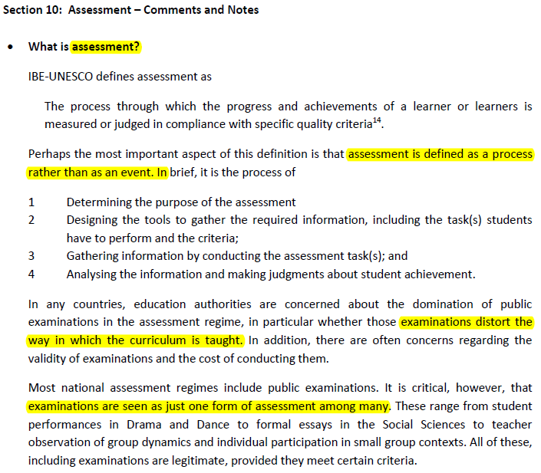
MAYBE NOT GO INTO THIS HERE (SKIP LAST FOUR SLIDES)

Slide 57
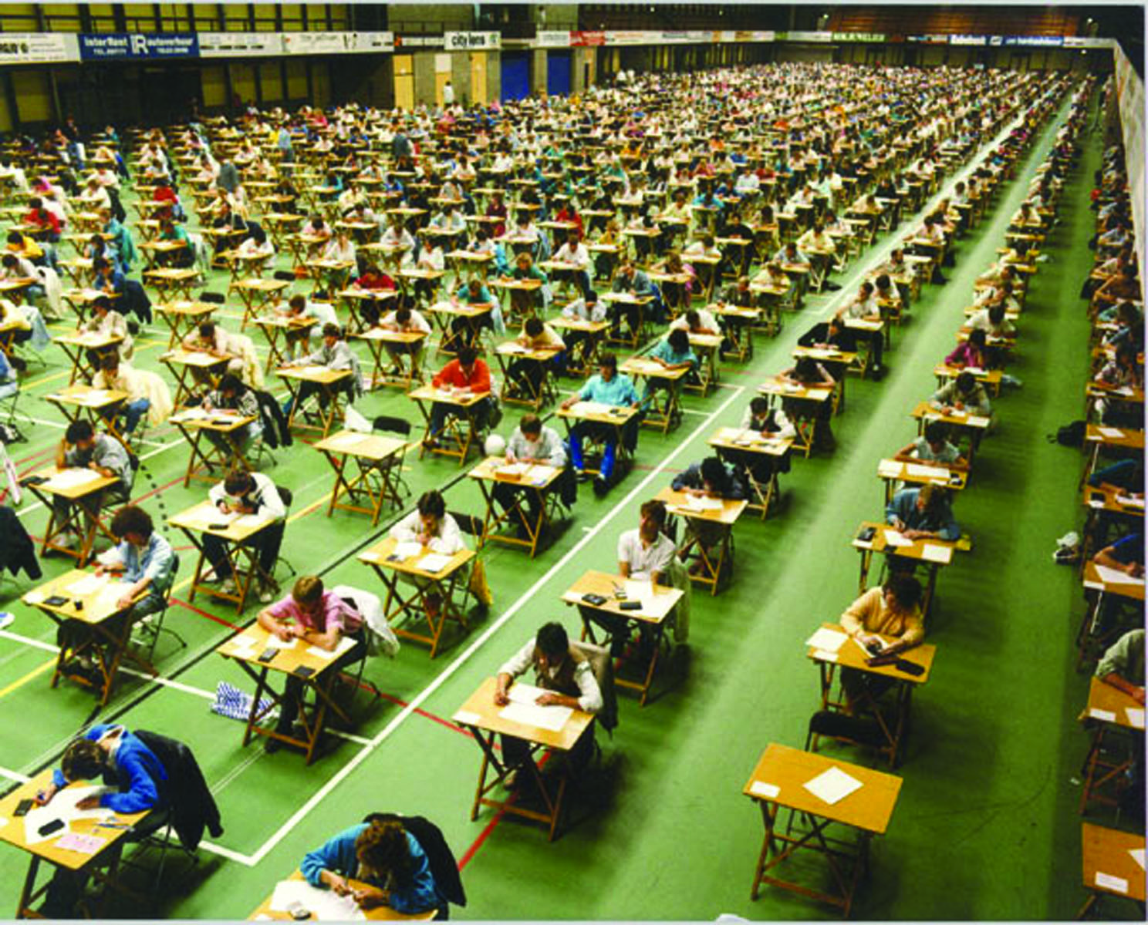

Slide 58
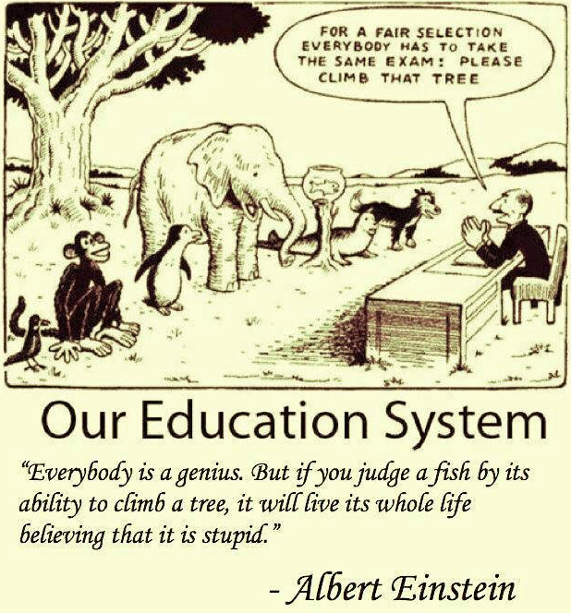

Slide 59
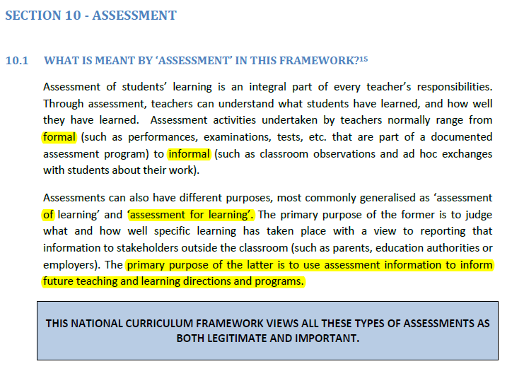

Slide 60
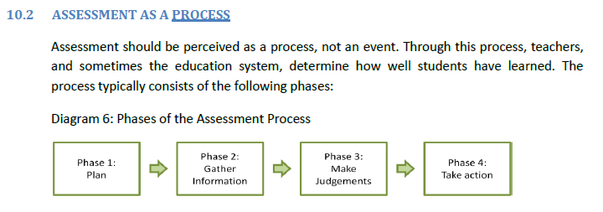

Slide 61
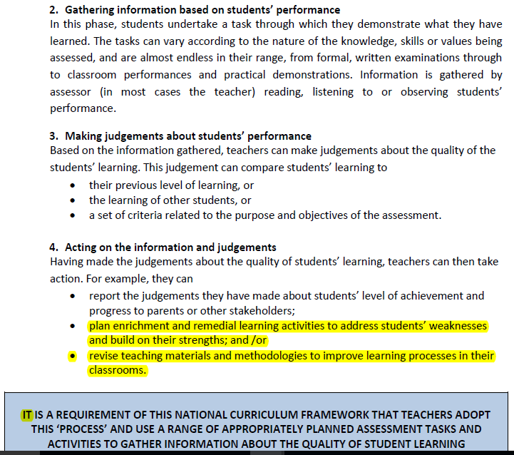

Slide 62
The idea of formative testing as a source of REMEDIATION is a key part of CBE in the USA
Key idea:
We go from TIME is the constant and ACHIEVEMENT is the variable
…To the exact opposite
Give learners the time they need and make sure they all achieve equally
YOUR TASK: REPORT ON MAIN POINTS
YOUTUBE – Dr Paul Leblanc

Slide 63
Interesting discussions about TESTS from our last visit to KICD
Attended mainly by KICD curriculum developers
SOME CONCLUSIONS FROM THESE DISCUSSIONS
Learners often fail tests because they cannot read the question correctly
Is there any solution to this?
Let’s look at a solution from Lextutor
www.lextutor.ca/vp/

Slide 64
2 Visit from KICD Testers
We sat in domain groups and prepared a BRIEF review of
‘AS WE TEST NOW vs HOW WE SHOULD TEST IN A COMPETENCE APRROACH’
They need to hear this

Slide 65
Our Main Conclusions
Obstacles to a competence approach (CA) in Kenya are often to do with existing modes of testing which are not competence oriented
Formative assessment is missing or ignored
Ss’ assessment remains:
a) pass-fail at the end
b) largely knowledge based

Slide 66
MORE conclusions 2
Testing will drive any curric reform: teachers will adjust their behaviour only when they see what is on the tests that measure success.
No real change in testing = no real change in curriculum
CA inherently and logically requires a lot of Formative Assessment, because knowledge application takes time and cannot be tested in a 3-hour summative
Esp since the psych-social dimension requires cooperative group work which cannot be included in 3-hr test
Although difficult, a way MUST be found to incorporate real Formative Assessment into final judgments of learner success

Slide 67
Conclusions 3
Curriculum is so jammed full that
There is rarely time to stop and work out the or application or use for any new knowledge that Cbe proposes
If formative assessment shows that any part of our teaching has failed for the majority of Ss, there is no time to fix and repeat this instruction
Formative assessment is rarely used even to give concrete feedback to the learner

Slide 68
Findings 4
A lot of the work Ss are doing in many domains is rather competence oriented already, in many interesting ways
But this is not reflected in the largely summative-only, knowledge-only testing

Slide 69
Conclusions 5
Formative assessment is a vital part of a learner-centered, competence approach,
Canada only gives 30-50% to the final summative assessment, ALL the rest is formative
Kenya plans something similar, as seen on Day 1
But the problem: it is not clear teachers are able or willing to be impartial in their formative assessments
Is this a teacher training issue?
Is there a risk of corruption?
Or is it a “there are no strict criteria for marking” issue?
Would double marking + clear criteria do the job?
Is a Quality Control Program the answer ?

Slide 70
THEREFORE, if we want this…
Then we can not assess for the first part only (knowledge)

Slide 71
Your Thoughts please!
TOPICS I MENTIONED WE WOULD DISCUSS
CBE only for city schools?
CBE only for science subjects?
CBE only for older or gifted learners?
CBE only for intact classrooms?
CBE and the importance of “situated learning”

Slide 72
Test on competency concepts
40 minutes – work alone – answer all questions
(about 10 minutes per question)
What are the main ideas of competency based education (CBE)?
What problems does CBE propose to address?
What does CBE imply for
Teaching
Testing
Students
What is the biggest challenge for CBE in Kenya?

Slide 73
16h30 – 17h
Tea/coffee break End of Day 1

