Slide 1
“Corpus Insights from Lextutor R&D that are too small to publish but too interesting to ignore” +1
Tom Cobb
SFU
March 12, 2015

Slide 2
Promised Abstract
For proponents of Data-Driven Language Learning, corpora and their frequency lists are supposed to be for learners, but applied linguists and course developers can learn some things too. Like whether it is actually possible to build an L2 lexicon through reading. Like what Zipf's Law really tells us we can and cannot do to simplify reading materials. Like how much English Francophone learners actually "get for free" (and Anglophones for French) from cognates at different stages of learning. And finally whether Data-Driven Learning actually "works" for language learners, and for what in particular. This talk will be a survey of current research spin-off from Lextutor development work.

Slide 3
Since a month ago, these ideas are now somewhat modified

Slide 4
New + improved focus Corpora and the frequency lists they generate are supposed to be for learners, …but applied linguists, course developers, and teachers can learn a few things too

Slide 5
Like what learners themselves see as their vocabulary learning needs

Slide 6
Like whether there are more friendly cognates or deadly faux-amis between English and French

Slide 7
Like whether it is more important in ESL to learn the Greco-Latin or Anglo-Saxon part of English …and whether this changes with purpose for learning and stage of learning

Slide 8
Like whether there are really a small number of Greco-Latin word roots that can generate most of the polysyllabic words in English

Slide 9
Like whether Zipf’s Law imposes constraints on how much a text can recycle its lexis

Slide 10
+ Like whether learners can actually benefit (for some part of their learning) from approaching language as a corpus, sliced and diced with software tools that expose its patterns

Slide 11
In other words ~
This talk will be a survey of current research spin-off from Lextutor work with frequency lists
A set of mini-talks
… with the subtext that there is a sort of data-driven-language learning for language teachers & researchers as well as learners

Slide 12
SPECIFICALLY,… One recent fruit of THE DDL APPROACH TO LANG LEARNING is a complete set of frequency lists for English -FamiLized -by k-level -SPOKEN + WRITTEN -US + UK

Slide 13
a complete set of freq lists allows Us to test some claims that roll around the esl UNIVERSE, UNTESTED AND unTESTABLE ~ some for a few weeks, some for a few decades

Slide 14
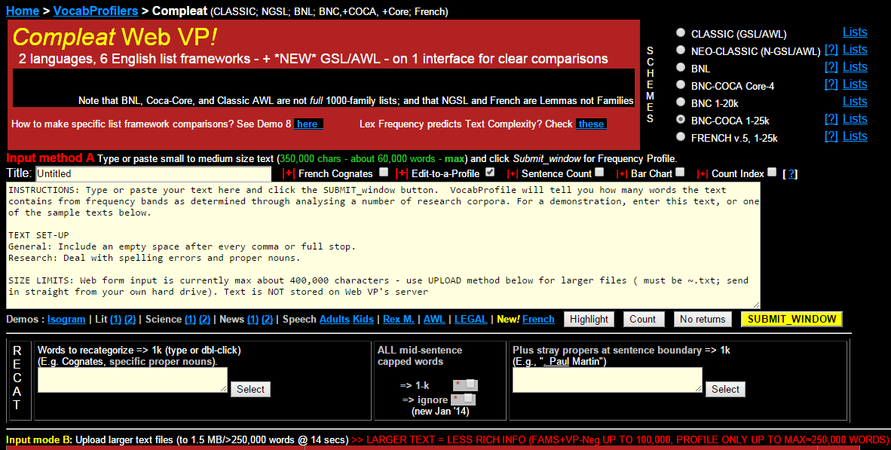
A complete set of Freq Lists like this

Slide 15
Such lists, allied with relevant software, allow us to evaluate previously unverifiable ideas like ~ Claim 1: There exists a small set of ‘Master Words’ whose parts can unlock most of the polysyllabic lexicon of English interesting if true…

Slide 16
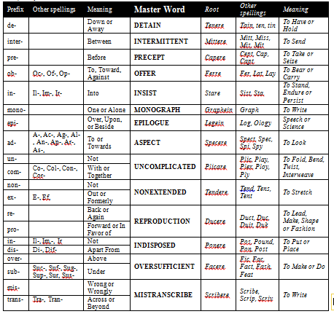
The famous ‘14 Master Words’

Slide 17
Finding 1
At all frequency level from 1 to 25k do the master-word-parts account for about 10% of tokens
And this is a generous estimate owing to overmatching (-log- matches ‘flog’ etc)

Slide 18
Claim 2: Frequency provides a reasonable basis for planning vocabulary development in a second language

Slide 19
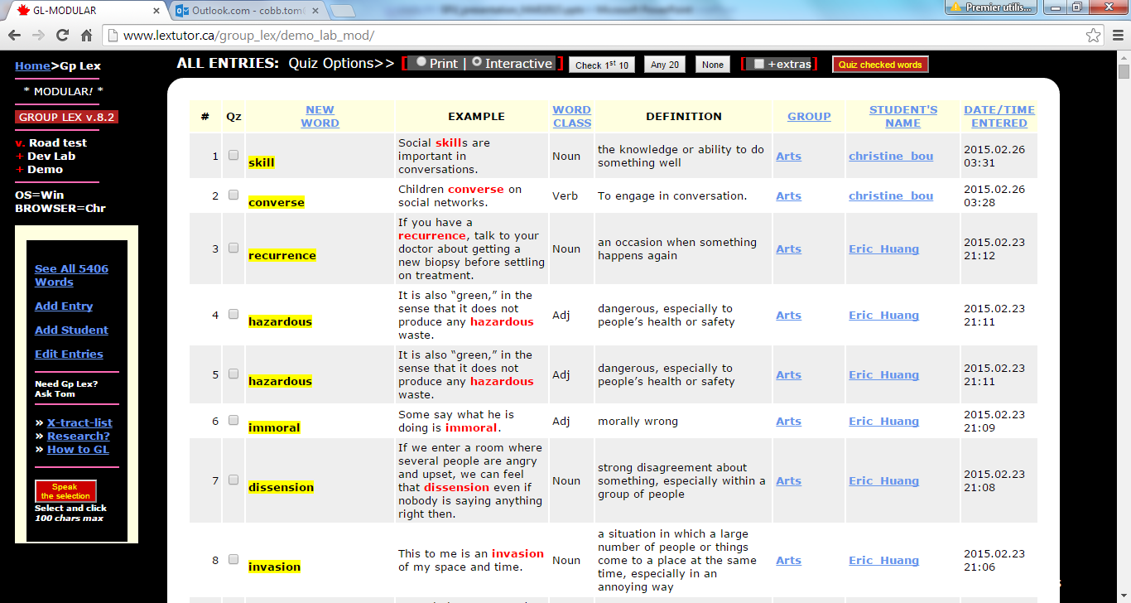
Group Lex

Slide 20
Finding 2
From 5,533 words entered fairly laboriously by 400+ Ss over 5 years ~
60% of the words that Ss enter are in 3k-6k zone
Supports the idea that instructed ESL vocab size is about 2,500 word families
Ss do not roam about the outer fringes of the lexicon but rather LARGELY seek out items that are in their ZPD
And…
60% of the words Ss enter are Greco-Latin in origin

Slide 21
Claim 3 The function words & very common words of English are mainly Anglo-Saxon… ~ but the rest of the lexicon (3k and up) is mainly Greco-Latin

Slide 22
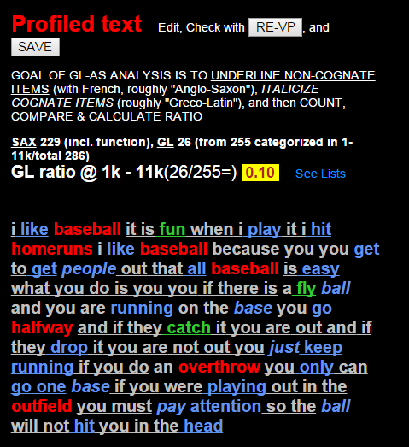
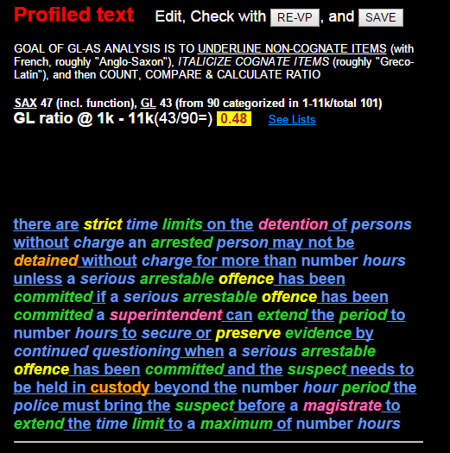
VocabProfile 2014 (BNC-Coca)

Slide 23
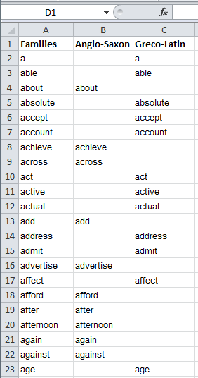
List carve-up
(← 1k, 2k … – 10k 11k)

Slide 24
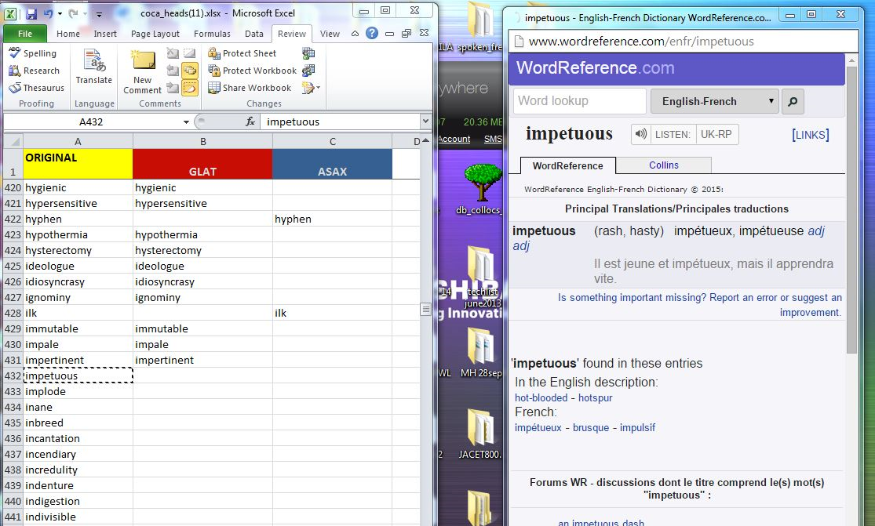

Slide 25
So does ASAX peter out after 1k-2k ?

Slide 26
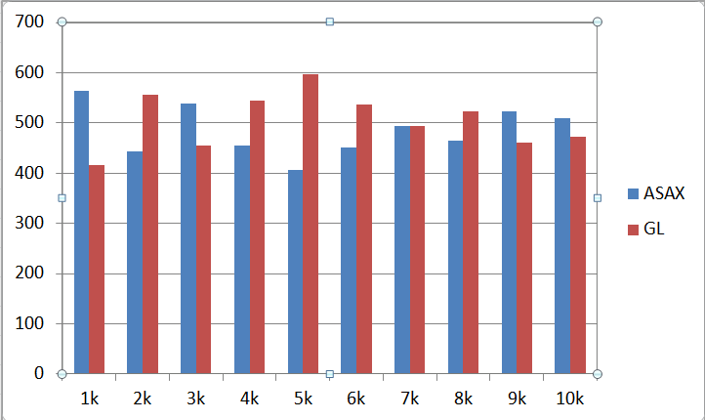
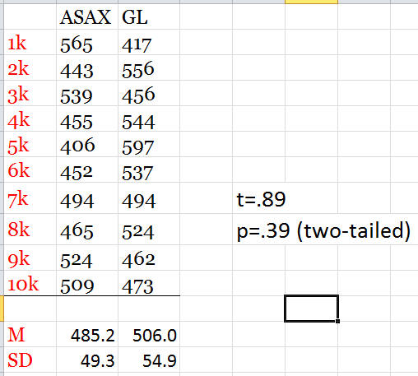

Slide 27
Finding 3
GLAT and ASAX are about equal all the way to 11k, and possibly beyond
(So, No, Francophones cannot just get by with “the French part of English”)
English Texts can vary from 0% to a max of about 50% GLAT

Slide 28
Claim 4 This massive etymo-duality of English would be pedagogically interesting, except that… The problem of faux-amis in English-French cognates is major

Slide 30
 |  | FORM (ortho)
M E A N I N G |  | SIMILAR | DIFFERENT
 | SIM- ILAR | (1) video (vidéo) | (2) school (école)
 | DIFF- ERENT | (3) actual (actuel) | (4) impeach (empêcher)

Slide 31
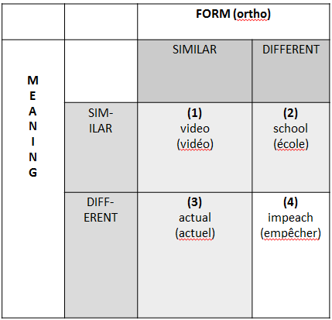
Finding 4
Less than 3% of GLAT cognates are in Box 4
(so 97% are probably usable)
So the faux-amis issue is really not major
Except for linguists – even governments know that Spanish immigrants will learn French and Germans learn English

Slide 32
VP-Cognates… usable for what? To modify the ‘cognativity’ of ESL reading texts up and down Launch francophone readers with lots of GLAT items Wean intermediates off cognates with lots of ASAX items

Slide 33
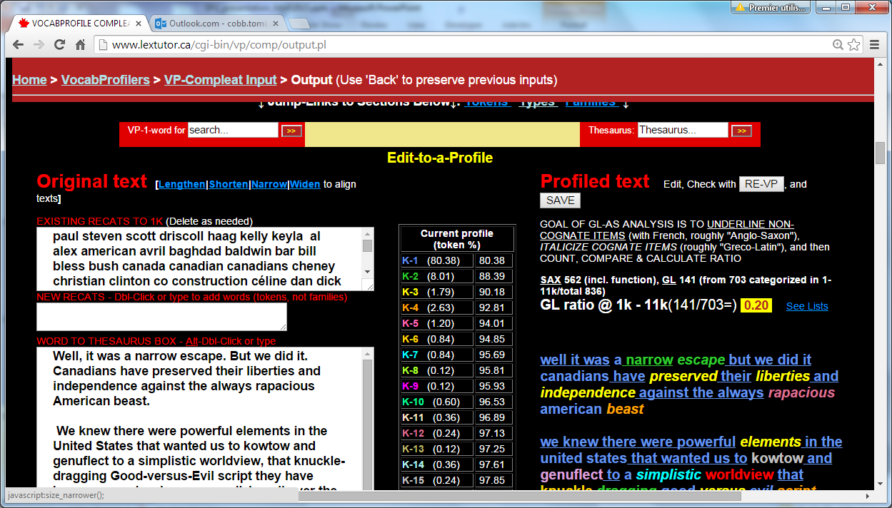
VocabProfile: Edit-to-a-Profile

Slide 34
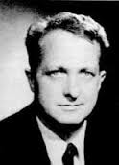
Claim 5 Not so fast with the text modifications… Zipf’s Law places strong constraints on how much texts can be modified Particularly with regard to the amount of word recycling they can contain

Slide 35
“Repetition is affected by Zipf’s law as it is in all meaning-focused activity, with over half of the different words appearing only once”
“The use of material written within a controlled vocabulary does little to change this spread of repetitions…”

Slide 36
“Graded readers cannot avoid Zipf’s law, and so half of the different words in a text are likely to occur only once.”

Slide 37
Paul Nation endorses this view

Slide 38
Summary of Zipfian “laws”
Any natural text is about 50% singletons
Regardless of text length
SUCH THAT
It is fruitless to try to write texts that have any substantial amount of extra recycling
To investigate this claim requires making some new software →

Slide 39
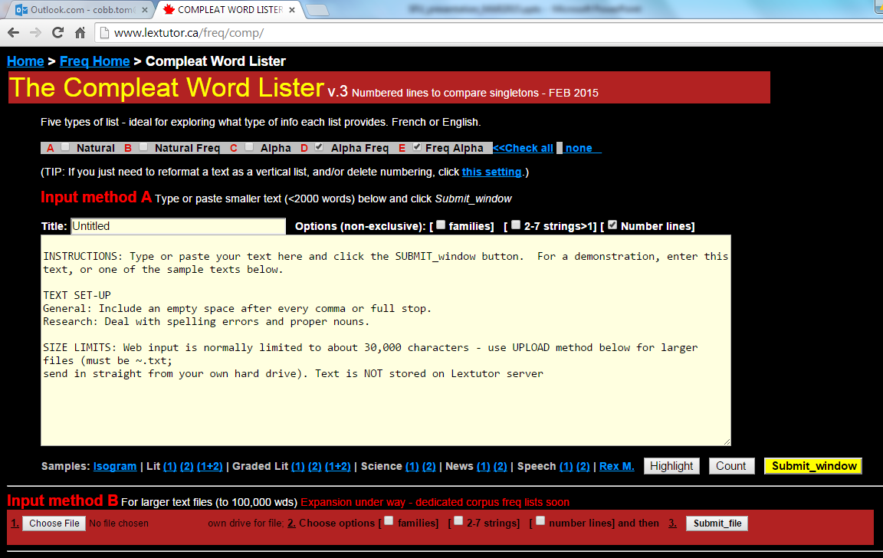
Muscle, know, helper

Slide 40
Finding 6
Ungraded novel
Ch 1 - 46%
Families - 38%
Ch2 – 45%
Families – 38%
Ch 1+2 – 36%
Families – 31%

Slide 41
Finding 6
Ungraded story
Ch 1 - 46%
Families - 38%
Ch2 – 45%
Families – 38%
Ch 1+2 – 36%
Families – 31%
Graded story
Ch 1 – 17%
Families 12%
Ch2 – 17%
Families 12 %
Ch 1+2 – 10%
Families – 6%

Slide 42
Finding 6 Texts can be modified to have any degree of repetition, from Ø words repeated to every word repeated Would Zipf consider these to be “natural” texts? Does it matter? Even unmodified texts increase their amount of recycling with length

Slide 43
Claim 7 French “does not have room for an Academic Word List” -Horst & Cobb, 2004

Slide 44
For a nuance on the finding to this one, come to AAAL in Toronto next week!

Slide 45
My first conclusion, then, is that corpora and frequency lists, queried by appropriate software, can show us the merits of some of the claims circulating in our field. But does this approach show our learners anything?

Slide 46
Claim 8 + ESL learners generally benefit from hands-on work with corpora

Slide 53
Finding 8 In 56 studies comparing some type of corpus investigation with some other approach to learning the same content, the corpus approach surpassed by an average 1.46 standard deviations

Slide 54
Example of e.s.=1.5 (a.k.a, a 1.5 std. dev. difference)
Control Group
Experimental group
Mean = 80
Std Dev = 10
Mean = 92
Std Dev = 5.5
12
------- =
8
92 – 80
------------------ =
√ ((10² + 5.5²)/2)
12
------- =
√ 64
1.5

Slide 55
The greater interest, of course, is not the overall finding, but what corpus consultation is more and less useful for what Writing Collocation Vocab development Translation … and for whom Beginners, Advanced, ESP, EAP…

Slide 56
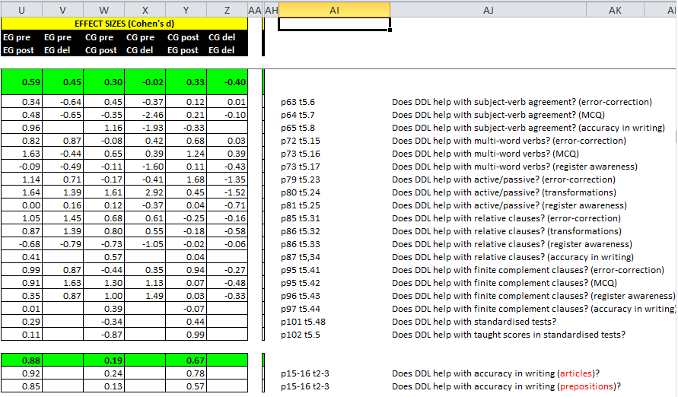
Bigger→

Slide 57
… For 217 comparison points (research questions)

Slide 58
Learn more, book now for AAAL 2016! www.lextutor.ca cobb.tom@sympatico.ca

Slide 59
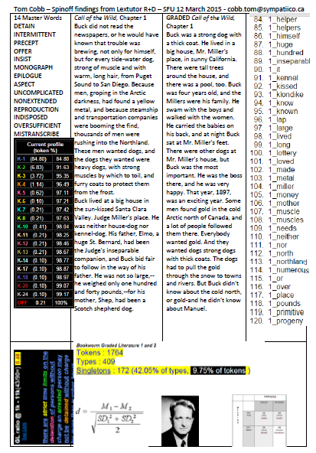
Meantime, your Quiz!

